Slide 1

1
WEEK 1
5-3-26

Slide 2
Who wrote Ephesians?
2
Paul wrote the book of Ephesians while under house arrest in Rome. This imprisonment occurred around A.D. 60–62, making it one of his four "Prison Epistles" (along with Philippians, Colossians, and Philemon).
Although the writing style is different, as we shall see, it also mentions Tychicus as the bearer of the letter (Eph 6:21–22), who also delivered Colossians, suggesting a common, early historical context.
TIK (as in tick) + ih (as in ka) + kus (as in kiss).

Slide 3
Ephesians 1:1-3
3
1 Paul, an apostle of Christ Jesus by the will of God, To the saints who are at Ephesus and [who are] faithful in Christ Jesus:
2 Grace to you and peace from God our Father and the Lord Jesus Christ.
3 Blessed [be] the God and Father of our Lord Jesus Christ, who has blessed us with every spiritual blessing in the heavenly [places] in Christ,

Slide 4
Ephesians 1:1-3
4
1 Paul, an apostle of Christ Jesus by the will of God, To the saints who are at Ephesus and [who are] faithful in Christ Jesus:
2 Grace to you and peace from God our Father and the Lord Jesus Christ.
3 Blessed [be] the God and Father of our Lord Jesus Christ, who has blessed us with every spiritual blessing in the heavenly [places] in Christ,
What does this infer?

Slide 5
Groups Believing Jesus is a Created Being:
5
Jehovah's Witnesses: They teach that Jesus is God's first creation, often identifying him as Michael the Archangel before his human life.
Christadelphians: They hold that Jesus did not exist before his birth, but was the promised Messiah created specifically to be the Son of God.
Church of God General Conference (Abrahamic Faith): This group believes Jesus was created and did not pre-exist his birth.
Unitarianism/Unitarian Universalist Church: They generally hold to the belief that Jesus is human, not God, often viewing him as a created teacher.”

Slide 6
God and father of Jesus Christ
6
Romans 15:6
“so that with one purpose and one voice you may glorify the God and Father of our Lord Jesus Christ”
2Corinthians 1:2-3
2 Grace to you and peace from God our Father and the Lord Jesus Christ. 3 Blessed be the God and Father of our Lord Jesus Christ,
2Corinthians 11:31
“The God and Father of the Lord Jesus, He who is blessed forever, knows that I am not lying.”
1Peter 1:3 3 “Blessed be the God and Father of our Lord Jesus Christ”

Slide 7
John 3:16
7
"For God so loved the world, that He gave His only begotten Son, that whoever believes in Him shall not perish, but have eternal life. ”

Slide 8
John 3:16
7
"For God so loved the world, that He gave His only begotten Son, that whoever believes in Him shall not perish, but have eternal life. ”
◄ Merriam Webster's Dictonary►
"Begotten" is the past participle of the verb beget, meaning to bring into existence, produce as offspring, or father, typically used to describe biological procreation. It frequently denotes being brought forth from a parent,

Slide 9
John 3:16
7
"For God so loved the world, that He gave His only begotten Son, that whoever believes in Him shall not perish, but have eternal life. ”
◄ Merriam Webster's Dictonary►
"Begotten" is the past participle of the verb beget, meaning to bring into existence, produce as offspring, or father, typically used to describe biological procreation. It frequently denotes being brought forth from a parent, or in theological terms, "begotten, not made" emphasizes being divinely generated rather than created. (Nicene Creed 325 AD)

Slide 10
John 3:16
8
"For God so loved the world, that He gave His only begotten Son, that whoever believes in Him shall not perish, but have eternal life. ”
◄ 3439. monogenés ►
Lexical Summary
monogenés: Only begotten, unique, one and only
Original Word: μονογενής
Part of Speech: Adjective
Transliteration: monogenés
Pronunciation: mo-no-ge-NACE
Phonetic Spelling: (mon-og-en-ace')
KJV: only (begotten, child)
NASB: only begotten, only

Slide 11
Hebrews 11:17
9
By faith Abraham, when he was tested, offered up Isaac, and he who had received the promises was offering up his only begotten son”
◄ 3439. monogenés ►
Lexical Summary
monogenés: Only begotten, unique, one and only
Original Word: μονογενής
Part of Speech: Adjective
Transliteration: monogenés
Pronunciation: mo-no-ge-NACE
Phonetic Spelling: (mon-og-en-ace')
KJV: only (begotten, child)
NASB: only begotten, only

Slide 12
Ephesians 1:4-5
10
4 just as He chose us in Him before the foundation of the world, that we would be holy and blameless before Him. In love
5 He predestined us to adoption as sons through Jesus Christ to Himself, according to the kind intention of His will,

Slide 13
Ephesians 1:4-6
11
4 just as He chose us in Him before the foundation of the world, that we would be holy and blameless before Him. In love
5 He predestined us to adoption as sons through Jesus Christ to Himself, according to the kind intention of His will,
6 to the praise of the glory of His grace, which He freely bestowed on us in the Beloved.

Slide 14
Ephesians 1:4-8
12
4 just as He chose us in Him before the foundation of the world, that we would be holy and blameless before Him. In love
5 He predestined us to adoption as sons through Jesus Christ to Himself, according to the kind intention of His will,
6 to the praise of the glory of His grace, which He freely bestowed on us in the Beloved.
7 In Him we have redemption through His blood, the forgiveness of our trespasses, according to the riches of His grace
8 which He lavished on us. In all wisdom and insight

Slide 15
Ephesians 1:9-12
13
9 He made known to us the mystery of His will, according to His kind intention which He purposed in Him
10 with a view to an administration suitable to the fullness of the times, [that is], the summing up of all things in Christ, things in the heavens and things on the earth. In Him
11 also we have obtained an inheritance, having been predestined according to His purpose who works all things after the counsel of His will,
12 to the end that we who were the first to hope in Christ would be to the praise of His glory.

Slide 16
Ephesians 1:13-14
14
13 In Him, you also, after listening to the message of truth, the gospel of your salvation-- having also believed, you were sealed in Him with the Holy Spirit of promise,
14 who is given as a pledge of our inheritance, with a view to the redemption of [God's own] possession, to the praise of His glory.

Slide 17
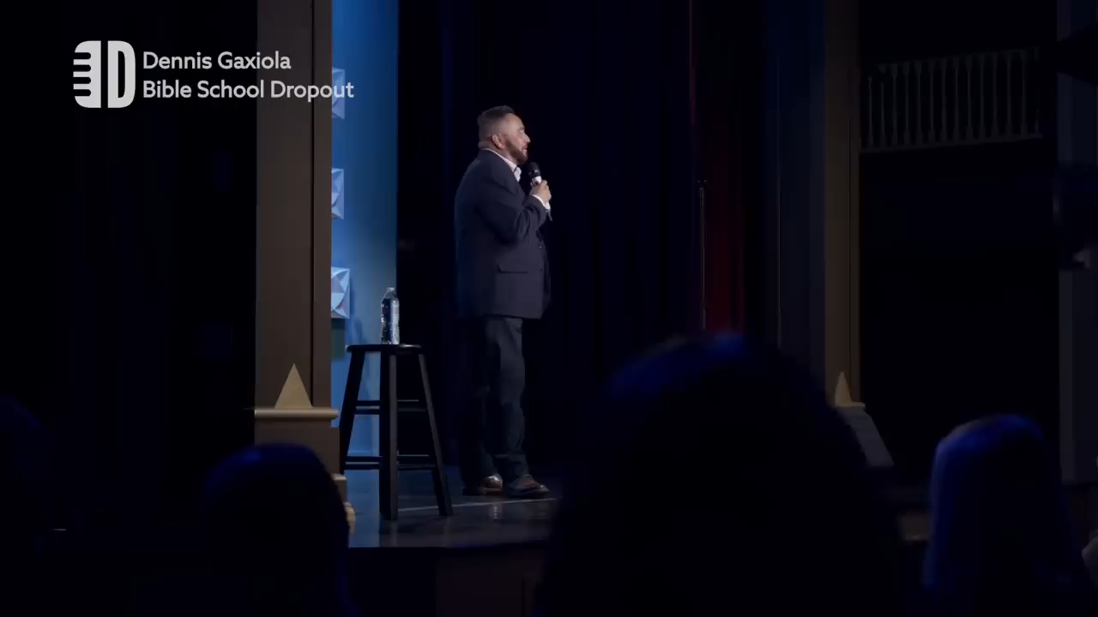
The bible is full of Latinos
15

