Slide 1

1
WEEK 4
5-24-26

Slide 2
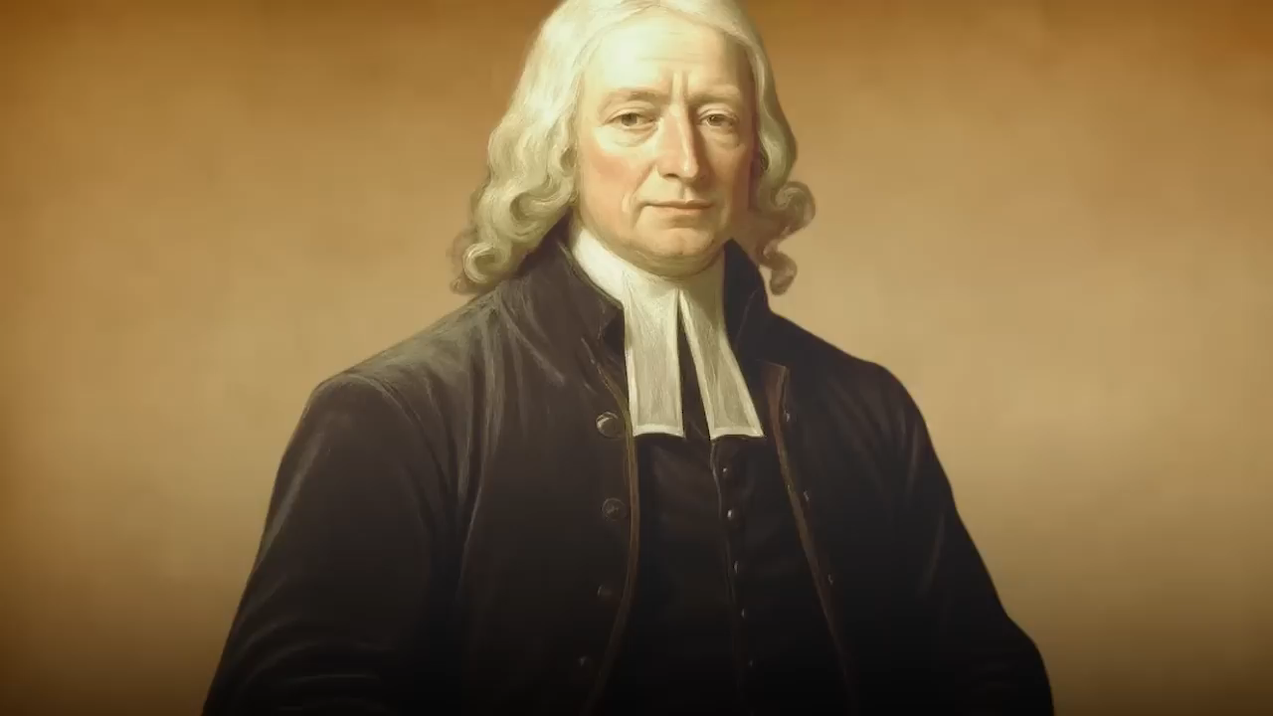
John Wesley 1750
2

Slide 3
Ephesians 2:10-12
3
10 For we are His workmanship, created in Christ Jesus for good works, which God prepared before and so that we would walk in them.

Slide 4
Ephesians 2:10
4
For we are His workmanship, created in Christ Jesus for good works, which God prepared before and so that we would walk in them. NASB
For we are God’s handiwork, created in Christ Jesus to do good works, which God prepared in advance for us to do. KJV
For we are God’s masterpiece. He has created us anew in Christ Jesus, so we can do the good things he planned for us long ago. New Living Translation

Slide 5
Romans 9: 23-24 (proetoimazó)
5
23 And He did so to make known the riches of His glory upon objects of mercy, which He prepared beforehand for glory,
24 namely us, whom He also called, not only from among Jews, but also from among Gentile

Slide 6
Ephesians 2:10 (proetoimazó)
6
For we are his workmanship, created in Christ Jesus unto good works, which God hath before ordained that we should walk in them. KJV

Slide 7
Thayer’s topical lexicon
7
Ephesians 2:10 shifts to deeds: “For we are God’s workmanship, created in Christ Jesus to do good works, which God prepared in advance for us to walk in”, underscoring a pre-arranged path of obedience for believers

Slide 8
Ephesians 2:8-10
8
8 For by grace you have been saved through faith; and that not of yourselves, [it is] the gift of God;
9 not as a result of works, so that no one may boast.
10 For we are His workmanship, created in Christ Jesus for good works, which God prepared beforehand so that we would walk in them.
Why are we to walk in good works?

Slide 9
Luke 15:3-6 the lost sheep
9
3 And so He told them this parable, saying,
4 “What man among you, if he has a hundred sheep and has lost one of them, does not leave the other ninety-nine in the [c]open pasture and go after the one that is lost, until he finds it?
5 And when he has found it, he puts it on his shoulders, rejoicing.
6 And when he comes home, he calls together his friends and his neighbors, saying to them, ‘Rejoice with me, because I have found my sheep that was lost.

Slide 10
Luke 15:7 the lost sheep
10
7 I tell you that in the same way, there will be more joy in heaven over one sinner who repents than over ninety-nine righteous people who have no need of repentance.

Slide 11
Luke 15:8-10 the lost coin
11
8 “Or what woman, if she has ten [d]silver coins and loses one coin, does not light a lamp and sweep the house and search carefully until she finds it?
9 And when she has found it, she calls together her friends and neighbors, saying, ‘Rejoice with me, because I have found the coin which I had lost!’
10 In the same way, I tell you, there is joy in the presence of the angels of God over one sinner who repents.

Slide 12
Luke 15:11-13 The Prodigal Son
12
11 And He said, “A man had two sons.
12 The younger of them said to his father, ‘Father, give me the share of the estate that [e]is coming to me.’ And so he divided his [f]wealth between them.
13 And not many days later, the younger son gathered everything together and went on a journey to a distant country, and there he squandered his estate in wild living.

Slide 13
Luke 15:14-16 The Prodigal Son
13
14 Now when he had [h]spent everything, a severe famine occurred in that country, and he began doing without.
15 So he went and [i]hired himself out to one of the citizens of that country, and he sent him into his fields to feed pigs.
16 And he longed to have his fill of the carob pods that the pigs were eating, and no one was giving him anything.

Slide 14
Luke 15:17-19 The Prodigal Son
14
17 But when he came to his senses, he said, ‘How many of my father’s hired laborers have more than enough bread, but I am dying here from hunger!
18 I will set out and go to my father, and will say to him, “Father, I have sinned against heaven, and [l]in your sight;
19 I am no longer worthy to be called your son; treat me as one of your hired laborers.”’

Slide 15
Luke 15:20 The Prodigal Son
15
20 So he set out and came to his father. But when he was still a long way off, his father saw him and felt compassion for him, and ran and embraced him and kissed him.

Slide 16
Luke 15:20 The Prodigal Son
16
20 So he set out and came to his father. But when he was still a long way off, his father saw him and felt compassion for him, and ran and embraced him and kissed him.
What is different in these three stories?

Slide 17
Ephesians 2:11-12
17
11 Therefore remember that formerly you, the Gentiles in the flesh, who are called "Uncircumcision" by the so-called "Circumcision," [which is] performed in the flesh by human hands-
12 [remember] that you were at that time separate from Christ, excluded from the commonwealth of Israel, and strangers to the covenants of promise, having no hope and without God in the world.

Slide 18
Ephesians 2:13-15
18
13 But now in Christ Jesus you who formerly were far off have been brought near by the blood of Christ.
14 For He Himself is our peace, who made both [groups into] one and broke down the barrier of the dividing wall,
15 by abolishing in His flesh the enmity, [which is] the Law of commandments [contained] in ordinances, so that in Himself He might make the two into one new man, [thus] establishing peace,

Slide 19
Ephesians 2:13-15
19
15 by abolishing in His flesh the enmity, [which is] the Law of commandments [contained] in ordinances, so that in Himself He might make the two into one new man, [thus] establishing peace,
What is an Ordinance?

Slide 20
Ephesians 2:13-15
20
15 by abolishing in His flesh the enmity, [which is] the Law of commandments [contained] in ordinances, so that in Himself He might make the two into one new man, [thus] establishing peace,
What is an Ordinance?
In the Bible, an ordinance generally refers to a rule, law, or established rite commanded by God. It comes from Hebrew and Greek words meaning "to decree" or "what is declared right

Slide 21
Ephesians 2:15-17
21
16 and might reconcile them both in one body to God through the cross, by it having put to death the enmity.
17 AND HE CAME AND PREACHED PEACE TO YOU WHO WERE FAR AWAY, AND PEACE TO THOSE WHO WERE NEAR; (Isaiah 57:17)
18 for through Him we both have our access in one Spirit to the Father.

Slide 22
Ephesians 2:19-22
22
19 So then you are no longer strangers and aliens, but you are fellow citizens with the saints, and are of God's household
,
20 having been built on the foundation of the apostles and prophets, Christ Jesus Himself being the corner [stone],
21 in whom the whole building, being fitted together, is growing into a holy temple in the Lord,
22 in whom you also are being built together into a dwelling of God in the Spirit.

Slide 23
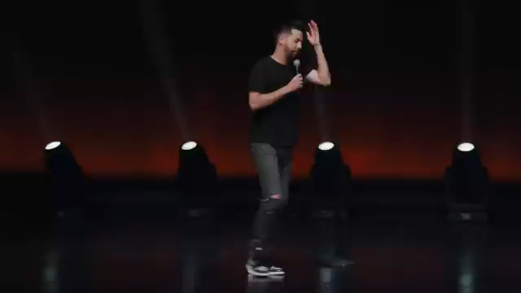
Are we like early Christians?
23

Slide 24
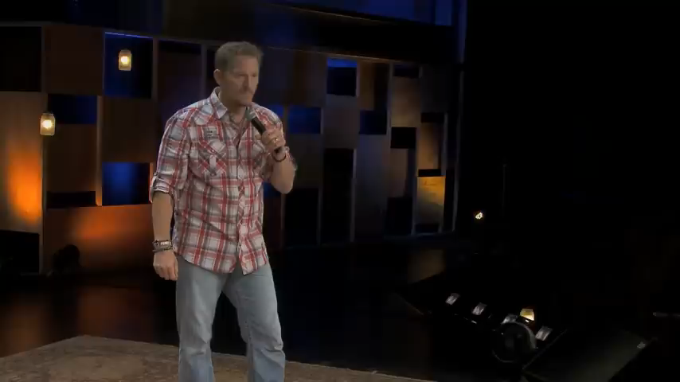
Praise music for men
24

