Slide 1

1
WEEK 5
5-31-26

Slide 2
Ephesians 2:10-12
3
10 For we are His workmanship, created in Christ Jesus for good works, which God prepared before and so that we would walk in them.

Slide 3
Ephesians 2:10
4
For we are His workmanship, created in Christ Jesus for good works, which God prepared before and so that we would walk in them. NASB
For we are God’s handiwork, created in Christ Jesus to do good works, which God prepared in advance for us to do. KJV
For we are God’s masterpiece. He has created us anew in Christ Jesus, so we can do the good things he planned for us long ago. New Living Translation

Slide 4
Romans 9: 23-24 (proetoimazó)
5
23 And He did so to make known the riches of His glory upon objects of mercy, which He prepared beforehand for glory,
24 namely us, whom He also called, not only from among Jews, but also from among Gentile

Slide 5
Ephesians 2:10 (proetoimazó)
6
For we are his workmanship, created in Christ Jesus unto good works, which God hath before ordained that we should walk in them. KJV

Slide 6
Thayer’s topical lexicon
7
Ephesians 2:10 shifts to deeds: “For we are God’s workmanship, created in Christ Jesus to do good works, which God prepared in advance for us to walk in”, underscoring a pre-arranged path of obedience for believers

Slide 7
Ephesians 2:8-10
8
8 For by grace you have been saved through faith; and that not of yourselves, [it is] the gift of God;
9 not as a result of works, so that no one may boast.
10 For we are His workmanship, created in Christ Jesus for good works, which God prepared beforehand so that we would walk in them.
Why are we to walk in good works?

Slide 8
Ephesians 2:11-12
17
11 Therefore remember that formerly you, the Gentiles in the flesh, who are called "Uncircumcision" by the so-called "Circumcision," [which is] performed in the flesh by human hands-
12 [remember] that you were at that time separate from Christ, excluded from the commonwealth of Israel, and strangers to the covenants of promise, having no hope and without God in the world.

Slide 9
Ephesians 2:13-15
18
13 But now in Christ Jesus you who formerly were far off have been brought near by the blood of Christ.
14 For He Himself is our peace, who made both [groups into] one and broke down the barrier of the dividing wall,
15 by abolishing in His flesh the enmity, [which is] the Law of commandments [contained] in ordinances, so that in Himself He might make the two into one new man, [thus] establishing peace,

Slide 10
Ephesians 2:13-15
19
15 by abolishing in His flesh the enmity, [which is] the Law of commandments [contained] in ordinances, so that in Himself He might make the two into one new man, [thus] establishing peace,
What is an Ordinance?

Slide 11
Ephesians 2:13-15
20
15 by abolishing in His flesh the enmity, [which is] the Law of commandments [contained] in ordinances, so that in Himself He might make the two into one new man, [thus] establishing peace,
What is an Ordinance?
In the Bible, an ordinance generally refers to a rule, law, or established rite commanded by God. It comes from Hebrew and Greek words meaning "to decree" or "what is declared right

Slide 12
Ephesians 2:15-17
21
16 and might reconcile them both in one body to God through the cross, by it having put to death the enmity.
17 AND HE CAME AND PREACHED PEACE TO YOU WHO WERE FAR AWAY, AND PEACE TO THOSE WHO WERE NEAR; (Isaiah 57:17)
18 for through Him we both have our access in one Spirit to the Father.

Slide 13
Ephesians 2:19-22
22
19 So then you are no longer strangers and aliens, but you are fellow citizens with the saints, and are of God's household
,
20 having been built on the foundation of the apostles and prophets, Christ Jesus Himself being the corner [stone],
21 in whom the whole building, being fitted together, is growing into a holy temple in the Lord,
22 in whom you also are being built together into a dwelling of God in the Spirit.

Slide 14
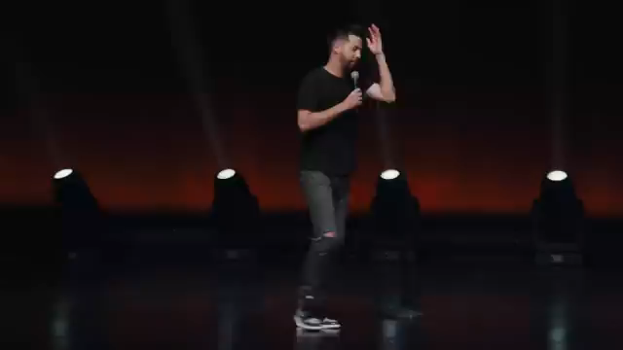
Are we like early Christians?
23

Slide 15
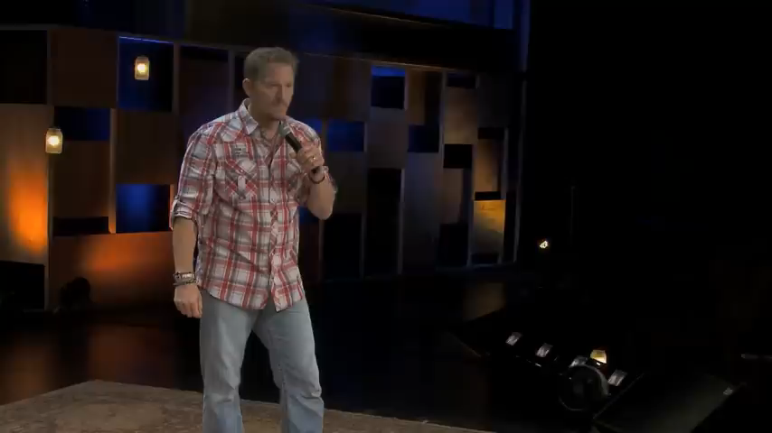
Praise music for men
24

