Slide 1

1
WEEK 7
6-14-26

Slide 2
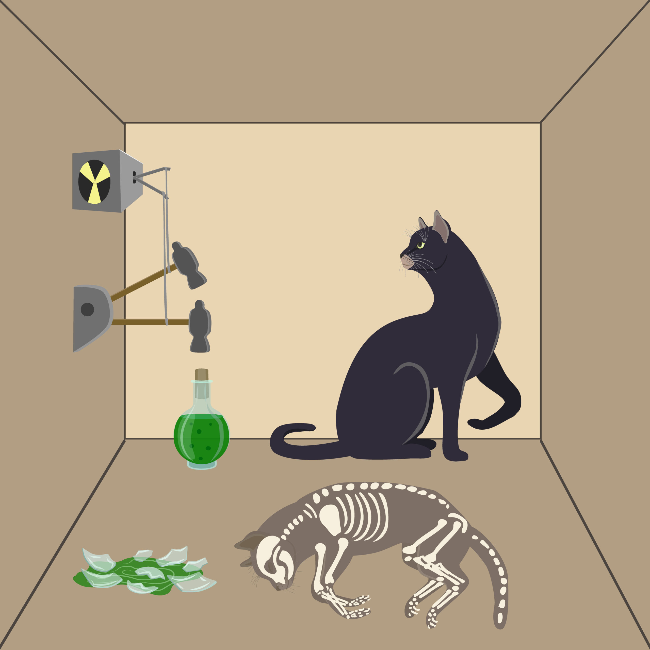
Schrödinger's cat
2

Slide 3
Schrödinger's cat
3
Erwin Schrödinger never meant for the cat to be taken seriously. The whole experiment was designed as a dark joke to show how ridiculous quantum mechanics could be if applied to the everyday world.
Schrödinger's Cat began as a conceptual joke between physicists Erwin Schrödinger and Albert Einstein.

Slide 4
John Macarthur on Larry King 2005
4
“You either believe in Jesus Christ or you don’t.
If you believe in Jesus Christ you’re going to heaven.
If you don’t, no matter what you have done in your life, you ain’t.”

Slide 5
You are not saved, and not saved at the same time indicating only a state of grace.
5
Ephesians 1:13-14
13 In Him, you also, after listening to the message of truth, the gospel of your salvation—having also believed, you were sealed in Him with the Holy Spirit of the promise,
14 who is a first installment of our inheritance, in regard to the redemption of God’s own possession, to the praise of His glory.

Slide 6
You are not saved, and not saved at the same time indicating only a state of grace.
6
Ephesians 2:8-9
8 For by grace you have been saved through faith; and this is not of yourselves, it is the gift of God;
9 not a result of works, so that no one may boast.

Slide 7
Ephesians 4:4-6
7
4 [There is] one body and one Spirit, just as also you were called in one hope of your calling;
5 one Lord, one faith, one baptism,
6 one God and Father of all who is over all and through all and in all.

Slide 8
Ephesians 4:7-8
8
7 But to each one of us grace was given according to the measure of Christ's gift.
8 Therefore it says, "WHEN HE ASCENDED ON HIGH, HE LED CAPTIVE A HOST OF CAPTIVES, AND HE GAVE GIFTS TO MEN."

Slide 9
Ephesians 4:7-8
9
7 But to each one of us grace was given according to the measure of Christ's gift.
8 Therefore it says, "WHEN HE ASCENDED ON HIGH, HE LED CAPTIVE A HOST OF CAPTIVES, AND HE GAVE GIFTS TO MEN.“ (Psalm 68:18)
The phrase “led captive a host captives” implies total subjugation of hostile forces. What once enslaved the believer—sin, death, and demonic oppression—is itself taken captive.

Slide 10
Ephesians 4:9-10
10
9 (Now this [expression], "He ascended," what does it mean except that He also had descended into the lower parts of the earth?
10 He who descended is Himself also He who ascended far above all the heavens, so that He might fill all things.)

Slide 11
Ephesians 4:11-13
11
11 And He gave some [as] apostles, and some [as] prophets, and some [as] evangelists, and some [as] pastors and teachers,
12 for the equipping of the saints for the work of service, to the building up of the body of Christ;
13 until we all attain to the unity of the faith, and of the knowledge of the Son of God, to a mature man, to the measure of the stature which belongs to the fullness of Christ.

Slide 12
Ephesians 4:14-16
12
14 As a result, we are no longer to be children, tossed here and there by waves and carried about by every wind of doctrine, by the trickery of men, by craftiness in deceitful scheming;
15 but speaking the truth in love, we are to grow up in all [aspects] into Him who is the head, [even] Christ,
16 from whom the whole body, being fitted and held together by what every joint supplies, according to the proper working of each individual part, causes the growth of the body for the building up of itself in love.

Slide 13
Ephesians 4:17-19
13
17 So this I say, and affirm together with the Lord, that you walk no longer just as the Gentiles also walk, in the futility of their mind,
18 being darkened in their understanding, excluded from the life of God because of the ignorance that is in them, because of the hardness of their heart;
19 and they, having become callous, have given themselves over to sensuality for the practice of every kind of impurity with greediness.

Slide 14
Ephesians 4:20-23
14
20 But you did not learn Christ in this way,
21 if indeed you have heard Him and have been taught in Him, just as truth is in Jesus,
22 that, in reference to your former manner of life, you lay aside the old self, which is being corrupted in accordance with the lusts of deceit,
23 and that you be renewed in the spirit of your mind,

Slide 15
Ephesians 4:24-27
15
24 and put on the new self, which in [the likeness of] God has been created in righteousness and holiness of the truth.
25 Therefore, laying aside falsehood, SPEAK TRUTH EACH ONE [of you] WITH HIS NEIGHBOR, for we are members of one another.
26 BE ANGRY, AND [yet] DO NOT SIN; do not let the sun go down on your anger, (Zechariah 8:16)
27 and do not give the devil an opportunity.

Slide 16
The Devil Slugworth & Jewish satan
16
In the 1971 film, Arthur Slugworth is introduced as a sinister competitor trying to steal Willy Wonka’s everlasting gobstopper by tempting the children. He is often viewed as a metaphorical tempter or devil figure.
The Jewish View: Judaism does not subscribe to the Christian concept of Satan. Instead, the Hebrew word haSatan means "the accuser" or "the adversary". In Jewish tradition, this figure acts as a kind of heavenly "devil’s advocate" whose job is to tempt mankind, test human character, and provide opportunities to exercise free will and conquer our evil inclinations. The Connection: This Jewish concept of a "heavenly prosecutor" perfectly mirrors Slugworth's actual role in the film. At the end of the story, it is revealed that Slugworth was working for Wonka the entire time. He was an assistant performing a necessary test to find an honest child who could resist temptation and prove their moral character.

Slide 17
Ephesians 4:28-30
17
28 He who steals must steal no longer; but rather he must labor, performing with his own hands what is good, so that he will have [something] to share with one who has need.
29 Let no unwholesome word proceed from your mouth, but only such [a word] as is good for edification according to the need [of the moment], so that it will give grace to those who hear.
30 Do not grieve the Holy Spirit of God, by whom you were sealed for the day of redemption.

Slide 18
Ephesians 4:31-32
18
31 Let all bitterness and wrath and anger and clamor and slander be put away from you, along with all malice.
32 Be kind to one another, tender-hearted, forgiving each other, just as God in Christ also has forgiven you.

Slide 19
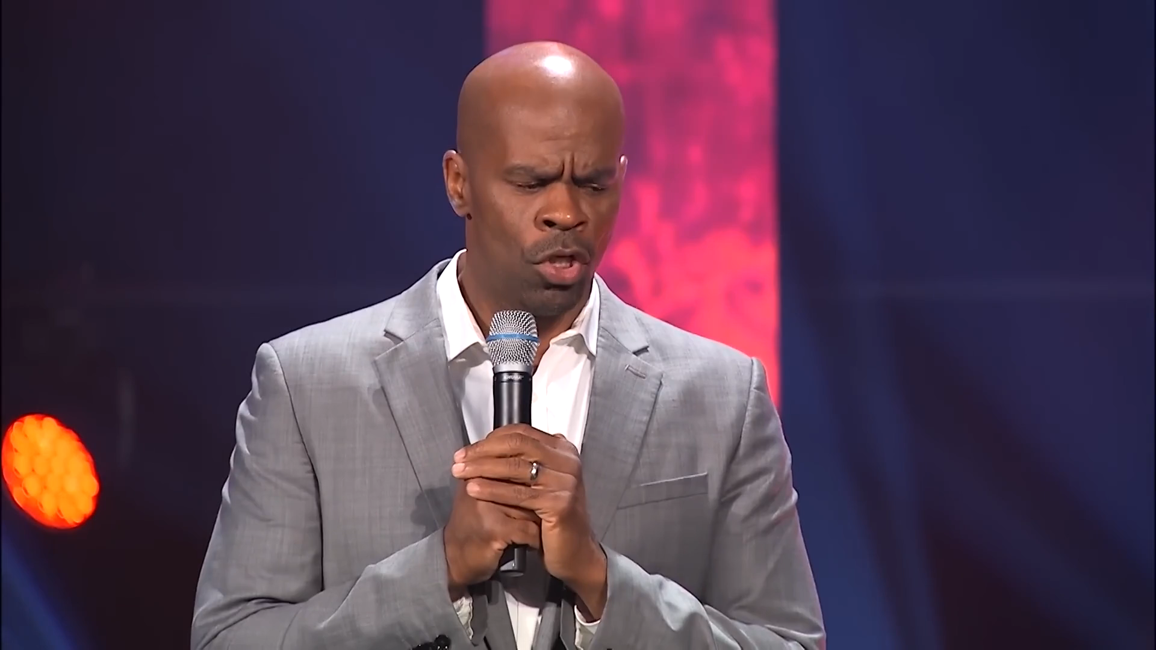
One body
19

