Slide 1
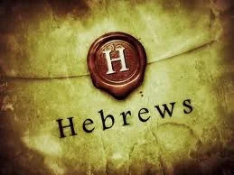
1
WEEK 10
10-18-26

Slide 2
We covered
2
1. Jubilee Year: The year debt is forgiven Slaves are freed, the land is restored. After 49 years, on the start of the 50th year which is also the first year counting towards the next Jubilee.
2. Jesus was born between 6 and 4 BC: Making Him “about thirty years old” at the start of His ministry in 26 AD. This was the last Jubilee year in Daniels 490 year prophecy.
3. The Essenes recognized the tie between Melchizedek and the Messiah and how the Jubilee year was a foreshadow of what the Messiah will bring to people.

Slide 3
We covered
3
4. Covenant: The word used for Covenant means it is not an agreed contract between two equals, but more of a last will and testament, a New Testament.
5. The Shedding of Blood: Does not mean bleeding, it, means death.
6. Stipulations to the Inheritance: The Testament cannot be changed after the Testator dies.
Titus 2:11 “For the grace of God has appeared, bringing salvation to all men,”
Since we know not all men are saved, what is the stipulation for salvation?

Slide 4
Daniel and Jesus
4
The start date for Daniel's 490-year (seventy sevens) prophecy is widely interpreted by biblical scholars as either 457 B.C., 445/444 B.C., or 454 B.C., depending on which royal decree to restore and rebuild Jerusalem is used.
Using 457 B.C. as the starting date you arrive at 33 AD.

Slide 5
Daniel and jesus
5
The start date for Daniel's 490-year (seventy sevens) prophecy is widely interpreted by biblical scholars as either 457 B.C., 445/444 B.C., or 454 B.C., depending on which royal decree to restore and rebuild Jerusalem is used.
Using 457 B.C. as the starting date you arrive at 33 AD.
Why 457 B.C. is Chosen?
The Decree of Artaxerxes: Ezra 7 records a comprehensive decree issued by Persian king Artaxerxes I in his seventh regnal year.
Chronological Calculation: Using established ancient chronological data for the reign of Persian kings and the Jewish fall-to-fall calendar, Artaxerxes' seventh regnal year corresponds precisely to 457 B.C.

Slide 6
Daniel and jesus
6
The start date for Daniel's 490-year (seventy sevens) prophecy is widely interpreted by biblical scholars as either 457 B.C., 445/444 B.C., or 454 B.C., depending on which royal decree to restore and rebuild Jerusalem is used.
Using 457 B.C. as the starting date you arrive at 33 AD.
Why 457 B.C. is Chosen?
The Decree of Artaxerxes: Ezra 7 records a comprehensive decree issued by Persian king Artaxerxes I in his seventh regnal year.
Chronological Calculation: Using established ancient chronological data for the reign of Persian kings and the Jewish fall-to-fall calendar, Artaxerxes' seventh regnal year corresponds precisely to 457 B.C.
Daniel 9:25
"So you are to know and discern [that] from the issuing of a decree to restore and rebuild Jerusalem until Messiah the Prince….”

Slide 7
Daniel 9:25-27
7
25 "So you are to know and discern [that] from the issuing of a decree to restore and rebuild Jerusalem until Messiah the Prince [there will be] seven weeks and sixty-two weeks; it will be built again, with plaza and moat, even in times of distress.
26 "Then after the sixty-two weeks the Messiah will be cut off and have nothing, and the people of the prince who is to come will destroy the city and the sanctuary. And its end [will come] with a flood; even to the end there will be war; desolations are determined.
27 "And he will make a firm (mighty) covenant with the many for one week, but (then) in the middle of the week he will put a stop to sacrifice and grain offering; and on the wing (extremity) of abominations [will come] one who makes desolate, even until a complete destruction, one that is decreed, is poured out on the one who makes desolate.“ (Prophetic Telescoping)

Slide 8
Daniel 9:25-27
8
25 "So you are to know and discern [that] from the issuing of a decree to restore and rebuild Jerusalem until Messiah the Prince [there will be] seven weeks and sixty-two weeks; it will be built again, with plaza and moat, even in times of distress.
26 "Then after the sixty-two weeks the Messiah will be cut off and have nothing, and the people of the prince who is to come will destroy the city and the sanctuary. And its end [will come] with a flood; even to the end there will be war; desolations are determined.
27 "And he will make a firm covenant with the many for one week, but in the middle of the week he will put a stop to sacrifice and grain offering; and on the wing of abominations [will come] one who makes desolate, even until a complete destruction, one that is decreed, is poured out on the one who makes desolate.“ (Prophetic Telescoping)
Matthew 24
15 "Therefore when you see the ABOMINATION OF DESOLATION which was spoken of through Daniel the prophet, standing in the holy place (let the reader understand),
16 then those who are in Judea must flee to the mountains.
17 "Whoever is on the housetop must not go down to get the things out that are in his house.
18 "Whoever is in the field must not turn back to get his cloak.

Slide 9
Daniel 9:25-27
9
25 "So you are to know and discern [that] from the issuing of a decree to restore and rebuild Jerusalem until Messiah the Prince [there will be] seven weeks and sixty-two weeks; it will be built again, with plaza and moat, even in times of distress.
26 "Then after the sixty-two weeks the Messiah will be cut off and have nothing, and the people of the prince who is to come will destroy the city and the sanctuary. And its end [will come] with a flood; even to the end there will be war; desolations are determined.
27 "And he will make a firm covenant with the many for one week, but in the middle of the week he will put a stop to sacrifice and grain offering; and on the wing of abominations [will come] one who makes desolate, even until a complete destruction, one that is decreed, is poured out on the one who makes desolate.“ (Prophetic Telescoping)
Luke 21
20 "But when you see Jerusalem surrounded by armies, then recognize that her desolation is near.
21 "Then those who are in Judea must flee to the mountains, and those who are in the midst of the city must leave, and those who are in the country must not enter the city;

Slide 10
Daniel 9:25-27
10
25 "So you are to know and discern [that] from the issuing of a decree to restore and rebuild Jerusalem until Messiah the Prince [there will be] seven weeks and sixty-two weeks; it will be built again, with plaza and moat, even in times of distress.
26 "Then after the sixty-two weeks the Messiah will be cut off and have nothing, and the people of the prince who is to come will destroy the city and the sanctuary. And its end [will come] with a flood; even to the end there will be war; desolations are determined.
27 "And he will make a firm covenant with the many for one week, but in the middle of the week he will put a stop to sacrifice and grain offering; and on the wing of abominations [will come] one who makes desolate, even until a complete destruction, one that is decreed, is poured out on the one who makes desolate.“ (Prophetic Telescoping)

Slide 11
Hebrews 7:1-2
11
1 For this Melchizedek, king of Salem, priest of the Most High God, who met Abraham as he was returning from the slaughter of the kings and blessed him,
2 to whom also Abraham apportioned a tenth part of all [the spoils], was first of all, by the translation [of his name], king of righteousness, and then also king of Salem, which is king of peace.
3 Without father, without mother, without genealogy, having neither beginning of days nor end of life, but made like the Son of God, he remains a priest perpetually.

Slide 12
Hebrews 10:1-4
12
1 For the Law, since it has [only] a shadow of the good things to come [and] not the very form of things, can never, by the same sacrifices which they offer continually year by year, make perfect those who draw near.
2 Otherwise, would they not have ceased to be offered, because the worshipers, having once been cleansed, would no longer have had consciousness of sins?
3 But in those [sacrifices] there is a reminder of sins year by year.
4 For it is impossible for the blood of bulls and goats to take away sins.

Slide 13
Hebrews 10:1-4
13
1 For the Law, since it has [only] a shadow of the good things to come [and] not the very form of things, can never, by the same sacrifices which they offer continually year by year, make perfect those who draw near.
2 Otherwise, would they not have ceased to be offered, because the worshipers, having once been cleansed, would no longer have had have felt guilty for their sins.
3 But in those [sacrifices] there is a reminder of sins year by year.
4 For it is impossible for the blood of bulls and goats to take away sins.

Slide 14
Hebrews 10:5-7
14
5 Therefore, when He comes into the world, He says, "SACRIFICE AND OFFERING YOU HAVE NOT DESIRED, BUT A BODY YOU HAVE PREPARED FOR ME;
6 IN WHOLE BURNT OFFERINGS AND [sacrifices] FOR SIN YOU HAVE TAKEN NO PLEASURE.
7 "THEN I SAID, 'BEHOLD, I HAVE COME (IN THE SCROLL OF THE BOOK IT IS WRITTEN OF ME) TO DO YOUR WILL, O GOD.'“
(Psalm 40:6–8)

Slide 15
Hebrews 10:5-7
15
5 Therefore, when He comes into the world, He says, "SACRIFICE AND OFFERING YOU HAVE NOT DESIRED, BUT A BODY YOU HAVE PREPARED FOR ME;
6 IN WHOLE BURNT OFFERINGS AND [sacrifices] FOR SIN YOU HAVE TAKEN NO PLEASURE.
7 "THEN I SAID, 'BEHOLD, I HAVE COME (IN THE SCROLL OF THE BOOK IT IS WRITTEN OF ME) TO DO YOUR WILL, O GOD.'“
(Psalm 40:6–8)
Psalm 40:6 in the Hebrew Masoretic text traditionally reads "my ears you have opened" (referring to a servant attentive to God's will), whereas the Greek Septuagint and the Epistle to the Hebrews translate or render it as "a body you have prepared for me".

Slide 16
Hebrews 10:8-10
16
8 After saying above, "SACRIFICES AND OFFERINGS AND WHOLE BURNT OFFERINGS AND [sacrifices] FOR SIN YOU HAVE NOT DESIRED, NOR HAVE YOU TAKEN PLEASURE [in them]" (which are offered according to the Law),
9 then He said, "BEHOLD, I HAVE COME TO DO YOUR WILL." He takes away the first in order to establish the second.
10 By this will we have been sanctified through the offering of the body of Jesus Christ once for all.

Slide 17
Hebrews 10:11-15
17
11 Every priest stands daily ministering and offering time after time the same sacrifices, which can never take away sins;
12 but He, having offered one sacrifice for sins for all time, SAT DOWN AT THE RIGHT HAND OF GOD,
13 waiting from that time onward UNTIL HIS ENEMIES BE MADE A FOOTSTOOL FOR HIS FEET. (Psalm 110:1)
14 For by one offering He has perfected for all time those who are sanctified.
15 And the Holy Spirit also testifies to us; for after saying,

Slide 18
Hebrews 10:11-15
18
11 Every priest stands daily ministering and offering time after time the same sacrifices, which can never take away sins;
12 but He, having offered one sacrifice for sins for all time, SAT DOWN AT THE RIGHT HAND OF GOD,
13 waiting from that time onward UNTIL HIS ENEMIES BE MADE A FOOTSTOOL FOR HIS FEET. (Psalm 110:1)
14 For by one offering He has perfected for all time those who are sanctified.
15 And the Holy Spirit also testifies to us; for after saying,
2 Corinthians 3:18
And we all, with unveiled face, continually seeing as in a mirror the glory of the Lord, are progressively being transformed into His image from [one degree of] glory to [even more] glory, which comes from the Lord, [who is] the Spirit. (AMP)

Slide 19
Hebrews 10:16-18
19
16 "THIS IS THE COVENANT THAT I WILL MAKE WITH THEM AFTER THOSE DAYS, SAYS THE LORD: I WILL PUT MY LAWS UPON THEIR HEART, AND ON THEIR MIND I WILL WRITE THEM," [He then says],
17 "AND THEIR SINS AND THEIR LAWLESS DEEDS I WILL REMEMBER NO MORE.“ (Jeremiah 31:34)
18 Now where there is forgiveness of these things, there is no longer [any] offering for sin.

Slide 20
Hebrews 10:19-22
20
19 Therefore, brethren, since we have confidence to enter the holy place by the blood of Jesus,
20 by a new and living way which He inaugurated for us through the veil, that is, His flesh,
21 and since [we have] a great priest over the house of God,
22 let us draw near with a sincere heart in full assurance of faith, having our hearts sprinkled [clean] from an evil conscience and our bodies washed with pure water.

Slide 21
Hebrews 10:19-22
21
19 Therefore, brethren, since we have confidence to enter the holy place by the blood of Jesus,
20 by a new and living way which He inaugurated for us through the veil, that is, His flesh,
21 and since [we have] a great priest over the house of God,
22 let us draw near with a sincere heart in full assurance of faith, having our hearts sprinkled [clean] from an evil conscience and our bodies washed with pure water.
Under the Old Covenant, priests had to ritually wash their bodies with water and have blood sprinkled on them before entering the tabernacle or sanctuary. Hebrews uses this exact parallel (hearts sprinkled and bodies washed) to show that believers are now consecrated as a royal priesthood able to enter God’s presence directly.

Slide 22
Hebrews 10:23-25
34
23 Let us hold fast the confession of our hope without wavering, for He who promised is faithful;
24 and let us consider how to stimulate one another to love and good deeds,
25 not forsaking our own assembling together, as is the habit of some, but encouraging [one another]; and all the more as you see the day drawing near.

Slide 23
Hebrews 10:26-29
23
26 For if we go on sinning willfully after receiving the knowledge of the truth, there no longer remains a sacrifice for sins,
27 but a terrifying expectation of judgment and THE FURY OF A FIRE WHICH WILL CONSUME THE ADVERSARIES.
28 Anyone who has set aside the Law of Moses dies without mercy on [the testimony of] two or three witnesses.
29 How much severer punishment do you think he will deserve who has trampled under foot the Son of God, and has regarded as unclean the blood of the covenant by which he was sanctified, and has insulted the Spirit of grace?

Slide 24
Hebrews 10:26-29
24
26 For if we go on sinning willfully after receiving the knowledge of the truth, there no longer remains a sacrifice for sins,
27 but a terrifying expectation of judgment and THE FURY OF A FIRE WHICH WILL CONSUME THE ADVERSARIES.
28 Anyone who has set aside the Law of Moses dies without mercy on [the testimony of] two or three witnesses.
29 How much severer punishment do you think he will deserve who has trampled under foot the Son of God, and has regarded as unclean the blood of the covenant by which he was sanctified, and has insulted the Spirit of grace?
Deuteronomy 19:15
“A single witness shall not rise up against a man on account of any iniquity or any sin which he has committed; on the evidence of two or three witnesses a matter shall be confirmed.
Deuteronomy 17:6
“On the evidence of two witnesses or three witnesses, he who is to die shall be put to death; he shall not be put to death on the evidence of one witness.

Slide 25
Hebrews 10:30-31
25
30 For we know Him who said, "VENGEANCE IS MINE, I WILL REPAY." And again, "THE LORD WILL JUDGE HIS PEOPLE."
31 It is a terrifying thing to fall into the hands of the living God.

Slide 26
Hebrews 10:32-36
26
32 But remember the former days, when, after being enlightened, you endured a great conflict of sufferings,
33 partly by being made a public spectacle through reproaches and tribulations, and partly by becoming sharers with those who were so treated.
34 For you showed sympathy to the prisoners and accepted joyfully the seizure of your property, knowing that you have for yourselves a better possession and a lasting one.
35 Therefore, do not throw away your confidence, which has a great reward.
36 For you have need of endurance, so that when you have done the will of God, you may receive what was promised.

Slide 27
Hebrews 10:32-36
27
37 FOR YET IN A VERY LITTLE WHILE, HE WHO IS COMING WILL COME, AND WILL NOT DELAY.
38 BUT MY RIGHTEOUS ONE SHALL LIVE BY FAITH; AND IF HE SHRINKS BACK, MY SOUL HAS NO PLEASURE IN HIM.
39 But we are not of those who shrink back to destruction, but of those who have faith to the preserving of the soul.

Slide 28
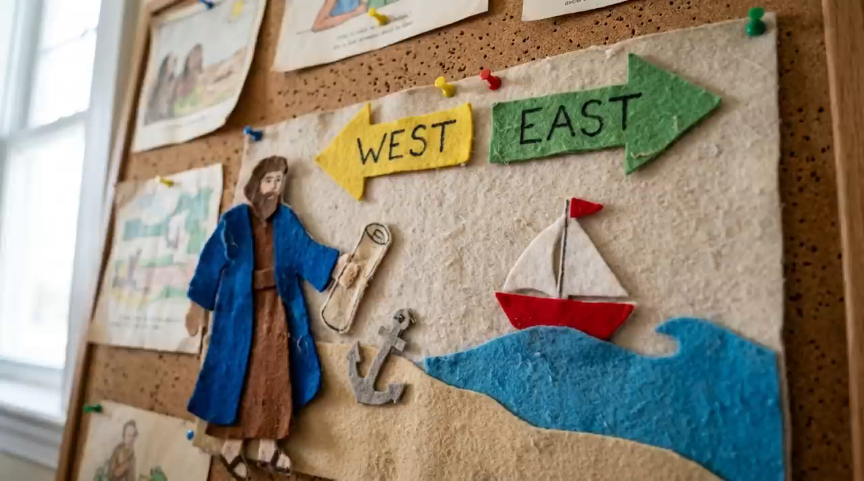
When are you saved?
28

