Slide 1
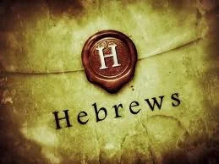
1
WEEK 6
9-20-26

Slide 2
Hebrews 5:1-4
2
1 For every high priest taken from among men is appointed on behalf of men in things pertaining to God, in order to offer both gifts and sacrifices for sins;
2 he can deal gently with the ignorant and misguided, since he himself also is beset with weakness;
3 and because of it he is obligated to offer [sacrifices] for sins, as for the people, so also for himself.
4 And no one takes the honor to himself, but [receives it] when he is called by God, even as Aaron was. (Exodus 28:1)

Slide 3
Hebrews 5:1-4
3
1 For every high priest taken from among men is appointed on behalf of men in things pertaining to God, in order to offer both gifts and sacrifices for sins;
2 he can deal gently with the ignorant and misguided, since he himself also is beset with weakness;
3 and because of it he is obligated to offer [sacrifices] for sins, as for the people, so also for himself.
4 And no one takes the honor to himself, but [receives it] when he is called by God, even as Aaron was. (Exodus 28:1)
◄ 3547. kahan ►
Strong's Exhaustive Concordance
A primitive root, apparently meaning to mediate in religious services; but used only as denominative from kohen

Slide 4
Hebrews 5:1-4
4
1 For every high priest taken from among men is appointed on behalf of men in things pertaining to God, in order to offer both gifts and sacrifices for sins;
2 he can deal gently with the ignorant and misguided, since he himself also is beset with weakness;
3 and because of it he is obligated to offer [sacrifices] for sins, as for the people, so also for himself.
4 And no one takes the honor to himself, but [receives it] when he is called by God, even as Aaron was. (Exodus 28:1)
◄ 3547. kahan ►
Strong's Exhaustive Concordance
A primitive root, apparently meaning to mediate in religious services; but used only as denominative from kohen
To mushroom: Formed from the noun mushroom (to grow rapidly like a fungus).
To eye: Formed from the noun eye (to look at someone or something closely).
To bottle: Formed from the noun bottle (to trap or contain something).

Slide 5
Hebrews 5:1-4
5
1 For every high priest taken from among men is appointed on behalf of men in things pertaining to God, in order to offer both gifts and sacrifices for sins;
2 he can deal gently with the ignorant and misguided, since he himself also is beset with weakness;
3 and because of it he is obligated to offer [sacrifices] for sins, as for the people, so also for himself.
4 And no one takes the honor to himself, but [receives it] when he is called by God, even as Aaron was. (Exodus 28:1)
◄ 3547. kahan ►
Strong's Exhaustive Concordance
A primitive root, apparently meaning to mediate in religious services; but used only as denominative from kohen
To mushroom: Formed from the noun mushroom (to grow rapidly like a fungus).
To eye: Formed from the noun eye (to look at someone or something closely).
To bottle: Formed from the noun bottle (to trap or contain something).
Instead of the standard pattern where a noun comes from a verb, a denominative takes an existing noun and builds a new word whose meaning incorporates that noun.

Slide 6
Hebrews 5:1-4
6
1 For every high priest taken from among men is appointed on behalf of men in things pertaining to God, in order to offer both gifts and sacrifices for sins;
2 he can deal gently with the ignorant and misguided, since he himself also is beset with weakness;
3 and because of it he is obligated to offer [sacrifices] for sins, as for the people, so also for himself.
4 And no one takes the honor to himself, but [receives it] when he is called by God, even as Aaron was. (Exodus 28:1)
◄ 3547. kahan ►
Strong's Exhaustive Concordance
A primitive root, apparently meaning to mediate in religious services; but used only as denominative from kohen

Slide 7
Hebrews 5:1-4
7
1 For every high priest taken from among men is appointed on behalf of men in things pertaining to God, in order to offer both gifts and sacrifices for sins;
2 he can deal gently with the ignorant and misguided, since he himself also is beset with weakness;
3 and because of it he is obligated to offer [sacrifices] for sins, as for the people, so also for himself.
4 And no one takes the honor to himself, but [receives it] when he is called by God, even as Aaron was. (Exodus 28:1)
◄ 3547. kahan ►
Strong's Exhaustive Concordance
A primitive root, apparently meaning to mediate in religious services; but used only as denominative from kohen
A kohen (plural: kohanim) is the Hebrew word for a Jewish priest who is a direct male descendant of Aaron, the brother of Moses.
The title is passed down from father to son. You cannot study or train to become a kohen; you must be born into the lineage.

Slide 8
Hebrews 5:1-4
8
1 For every high priest taken from among men is appointed on behalf of men in things pertaining to God, in order to offer both gifts and sacrifices for sins;
2 he can deal gently with the ignorant and misguided, since he himself also is beset with weakness;
3 and because of it he is obligated to offer [sacrifices] for sins, as for the people, so also for himself.
4 And no one takes the honor to himself, but [receives it] when he is called by God, even as Aaron was.

Slide 9
9
haftarah
Haftarah means "conclusion" or "ending" in Hebrew and refers to a reading from the biblical Books of the Prophets (Nevi'im). This is read every Sabbat and Holy Days.

Slide 10
10
Historical background
The most common explanation for the beginning of the Haftarah is that in 168 BC, when the Jews were under the rule of the Seleucid (Greeks) King Antiochus IV Epiphanes , they were forbidden to read from the Torah. The decree, however, was limited to the Five Books of Moses, so the sages instituted that a section of the Prophets be read instead, usually an idea that was related to the Torah reading that should have been read that week. This custom stuck even after it became safe to read from the Torah again.

Slide 11
Isaiah 53
11
1 Who has believed our message? And to whom has the arm of the LORD been revealed?
2 For He grew up before Him like a tender shoot, And like a root out of parched ground; He has no [stately] form or majesty That we should look upon Him, Nor appearance that we should be attracted to Him.
3 He was despised and forsaken of men, A man of sorrows and acquainted with grief; And like one from whom men hide their face He was despised, and we did not esteem Him.
4 Surely our griefs He Himself bore, And our sorrows He carried; Yet we ourselves esteemed Him stricken, Smitten of God, and afflicted.
5 But He was pierced through for our transgressions, He was crushed for our iniquities; The chastening for our well-being [fell] upon Him, And by His scourging we are healed.
6 All of us like sheep have gone astray, Each of us has turned to his own way; But the LORD has caused the iniquity of us all To fall on Him.
7 He was oppressed and He was afflicted, Yet He did not open His mouth; Like a lamb that is led to slaughter, And like a sheep that is silent before its shearers, So He did not open His mouth.

Slide 12
Isaiah 53
12
8 By oppression and judgment He was taken away; And as for His generation, who considered That He was cut off out of the land of the living For the transgression of my people, to whom the stroke [was due]?
9 His grave was assigned with wicked men, Yet He was with a rich man in His death, Because He had done no violence, Nor was there any deceit in His mouth.
10 But the LORD was pleased To crush Him, putting [Him] to grief; If He would render Himself [as] a guilt offering, He will see [His] offspring, He will prolong [His] days, And the good pleasure of the LORD will prosper in His hand.
11 As a result of the anguish of His soul, He will see [it and] be satisfied; By His knowledge the Righteous One, My Servant, will justify the many, As He will bear their iniquities.
12 Therefore, I will allot Him a portion with the great, And He will divide the booty with the strong; Because He poured out Himself to death, And was numbered with the transgressors; Yet He Himself bore the sin of many, And interceded for the transgressors.

Slide 13
13
Historical background
Dr Eitan Bar from the ministry of One For Israel writes in an article about a Jewish historian from the 17th century:
His name was Raphael Levi, and he admitted that at that time, the rabbis were encountering quite a conundrum with regard to Isaiah 53.
However, every time the congregations got to the section in Isaiah that described the suffering servant in chapter 53, actually the description begins in chapter 52, “arguments and great confusion” would break out amongst the congregants. What or who was Isaiah talking about…it sounds very, very, very much like the description of the Christians describing Jesus.
So, the rabbis felt the best way to deal with this issue was to simply remove the offending passage from the synagogue readings altogether. Starting in the middle of Isaiah 52 and all of Isaiah 53, those portions were completely removed. No more problem!

Slide 14

Street interviews in Israel
14

Slide 15
Hebrews 5:5
15
5 So also Christ did not glorify Himself so as to become a high priest, but He who said to Him, "YOU ARE MY SON, TODAY I HAVE BEGOTTEN YOU"; (Psalm 2:7-8)

Slide 16
Hebrews 5:5
16
5 So also Christ did not glorify Himself so as to become a high priest, but He who said to Him, "YOU ARE MY SON, TODAY I HAVE BEGOTTEN YOU"; (Psalm 2:7-8)
7 “I will surely tell of the decree of the Lord:
He said to Me, ‘You are My Son,
Today I have begotten You.
8 ‘Ask of Me, and I will surely give the nations as Your inheritance,
And the very ends of the earth as Your possession.
This is a direct quote from Psalm 2:7. Psalm 2 is about God's choice of David as King over Israel. In this Psalm God first declares himself sovereign over the earth, while rebuking the other nations who are attempting to exert their own rule over Israel.

Slide 17
Hebrews 5:5
17
5 So also Christ did not glorify Himself so as to become a high priest, but He who said to Him, "YOU ARE MY SON, TODAY I HAVE BEGOTTEN YOU"; (gennao)
“Do not be amazed that I said to you, ‘You must be born (gennao) again.” (John 3:7)
“I am writing this not to shame you but to warn you as my dear children…for in Christ Jesus I became your father (gennao – ‘begat you’) through the gospel.” (1 Corinthians 4:14-15)
“I appeal to you for my child Onesimus, whom I have begotten (gennao) in my imprisonment,” (Philemon 1:10)

Slide 18
Hebrews 5:5
18
5 So also Christ did not glorify Himself so as to become a high priest, but He who said to Him, "YOU ARE MY SON, TODAY I HAVE BEGOTTEN YOU"; (Psalm 2:7)
6 just as He says also in another [passage], "YOU ARE A PRIEST FOREVER ACCORDING TO THE ORDER OF MELCHIZEDEK."

Slide 19
Genesis 14:18-20
19
18 And Melchizedek king of Salem brought out bread and wine; now he was a priest of God Most High.
19 He blessed him and said, "Blessed be Abram of God Most High, Possessor of heaven and earth;
20 And blessed be God Most High, Who has delivered your enemies into your hand." He gave him a tenth of all.

Slide 20
Genesis 14:18-20
20
18 And Melchizedek king of Salem brought out bread and wine; now he was a priest of God Most High.
19 He blessed him and said, "Blessed be Abram of God Most High, Possessor of heaven and earth;
20 And blessed be God Most High, Who has delivered your enemies into your hand." He gave him a tenth of all.
Chabad.com
Chabad is a Hebrew acronym for three intellectual faculties: Chochmah (wisdom), Binah (understanding), and Da'at (knowledge)

Slide 21
Midrash complied between 400-1200 Ad
21
The Midrash explains that Shem/Melchizedek served as a Kohen (Priest).
Although before the Torah was given, the firstborn of each family would perform priestly service, and, according to Rashi, Japath was Noah’s firstborn, still Noah specifically chose Shem for this sacred role, even giving him the clothing made by G‑d for Adam, which represented the clothing of the High Priest.
It was in this spirit that Avraham gave Melchizedek tithes—a tenth of the spoils of war—to express gratitude and honor to Melchizedek as a Priest of G‑d.
Although Melchizedek was the serving Priest at the time, the Talmud reads a nuance in the Torah’s words to explain why the Priesthood was transferred to Abraham.

Slide 22
Midrash complied between 400-1200 Ad
22
Melchizedek blessed Abraham before he blessed G‑d, saying “Blessed be Abram” prior to “Blessed be the Most High G‑d.”
Although he meant well, this breach of protocol (placing the servant before the Master) was considered a failing.
As a result, G‑d transferred the Priesthood from Melchizedek’s descendants to Abraham’s. As the Talmud puts it, “He [Melchizedek] was a Priest, but his descendants were not.”

Slide 23
Genesis 14:18-20
23
In Hebrew, the name Melchizedek (מַלְכִּי־צֶדֶק) means "king of righteousness" or "my king is righteous.
"Breakdown of the Name Melekh: Means "king" or "my king".
Tzedek (צֶדֶק): Means "righteousness," "justice," or "fairness".
In Hebrew, Salem (שָׁלֵם, Shalem) means means “perfect", "whole", “safe” or "complete“.
18 And Melchizedek king of Salem brought out bread and wine; now he was a priest of God Most High.
19 He blessed him and said, "Blessed be Abram of God Most High, Possessor of heaven and earth;
20 And blessed be God Most High, Who has delivered your enemies into your hand." He gave him a tenth of all.

Slide 24
Genesis 14:18-20
24
In Hebrew, the name Melchizedek (מַלְכִּי־צֶדֶק) means "king of righteousness" or "my king is righteous.
"Breakdown of the Name Melekh (מֶלֶךְ) or Malki (מַלְכִּי): Means "king" or "my king".
Tzedek (צֶדֶק): Means "righteousness," "justice," or "fairness".
In Hebrew, Salem (שָׁלֵם, Shalem) means "peace", "whole", or "complete"
18 And Melchizedek king of Salem brought out bread and wine; now he was a priest of God Most High.
19 He blessed him and said, "Blessed be Abram of God Most High, Possessor of heaven and earth;
20 And blessed be God Most High, Who has delivered your enemies into your hand." He gave him a tenth of all.
◄ Psalm 76 ►
1 God is known in Judah; His name is great in Israel.
2 His tabernacle is in Salem; His dwelling place also is in Zion.

Slide 25
Hebrews 5:7-8
25
7 In the days of His flesh, He offered up both prayers and supplications with loud crying and tears to the One able to save Him from death, and He was heard because of His piety.
8 Although He was a Son, He learned obedience from the things which He suffered.

Slide 26
Why Warnings concerning salvation?
26
The Warning Passages
Hebrews 6:4–6: Describes people who were "enlightened," tasted the heavenly gift, and shared in the Holy Spirit, yet "fell away." Many view this as a clear warning that genuine believers can abandon their faith and reject salvation.
Hebrews 10:26–29: Warns against willfully going on sinning after receiving the knowledge of the truth, speaking of a terrifying expectation of judgment for those who have profaned the "blood of the covenant.“
Hebrews 3:12–14: States that believers "share in Christ" only if they hold their original confidence firm to the end, implying endurance is required to remain in Christ.

Slide 27
Why Warnings concerning salvation?
27
The Warning Passages
Hebrews 6:4–6: 4 For in the case of those who have once been enlightened and have tasted of the heavenly gift and have been made partakers of the Holy Spirit, 5 and have tasted the good word of God and the powers of the age to come, 6 and [then] have fallen away, it is impossible to renew them again to repentance, since they again crucify to themselves the Son of God and put Him to open shame.
Hebrews 10:26–28: 26 For if we go on sinning willfully after receiving the knowledge of the truth, there no longer remains a sacrifice for sins, 27 but a terrifying expectation of judgment and THE FURY OF A FIRE WHICH WILL CONSUME THE ADVERSARIES. 28 Anyone who has set aside the Law of Moses dies without mercy on [the testimony of] two or three witnesses.
Hebrews 3:12–14: 12 Take care, brethren, that there not be in any one of you an evil, unbelieving heart that falls away from the living God. 13 But encourage one another day after day, as long as it is [still] called "Today," so that none of you will be hardened by the deceitfulness of sin. 14 For we have become partakers of Christ, if we hold fast the beginning of our assurance firm until the end,

Slide 28
Who is Michael Steven Heiser?
28
Michael Steven Heiser (February 14, 1963 – February 20, 2023)
Education: He earned a Ph.D. in Hebrew Bible and Semitic Languages from the University of Wisconsin-Madison and an M.A. in Ancient History from the University of Pennsylvania.
Roles: He worked as a scholar-in-residence for Logos Bible Software for 15 years and later served as the executive director of the AWKNG School of Theology.

Slide 29
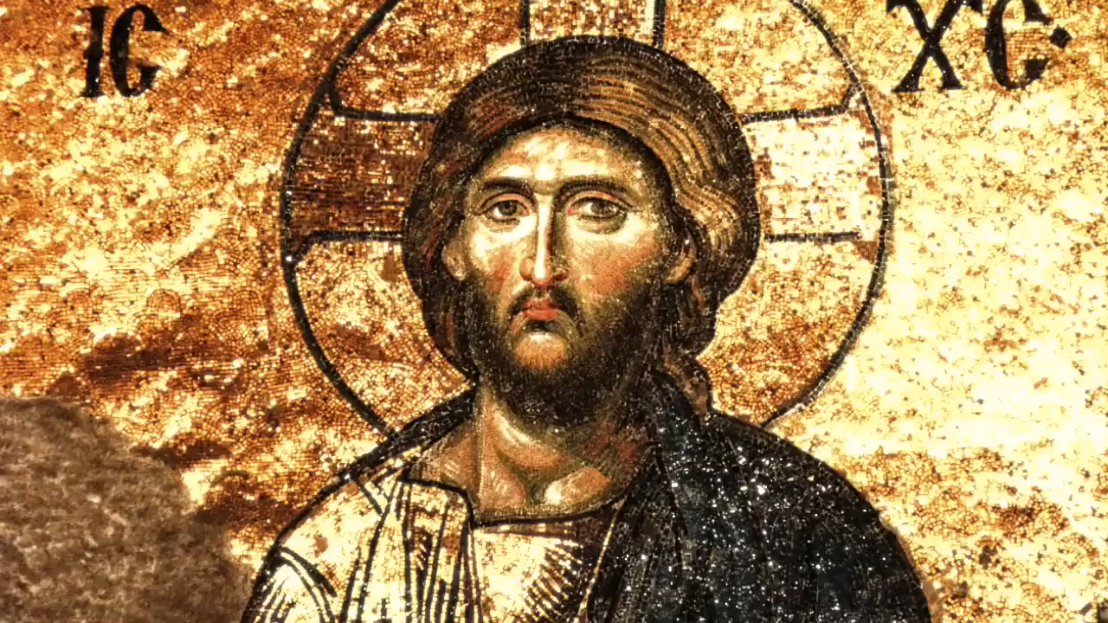
Why Warnings concerning salvation?
29

