Slide 1
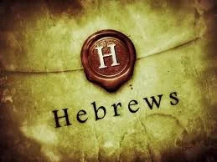
1
WEEK 8
10-4-26

Slide 2
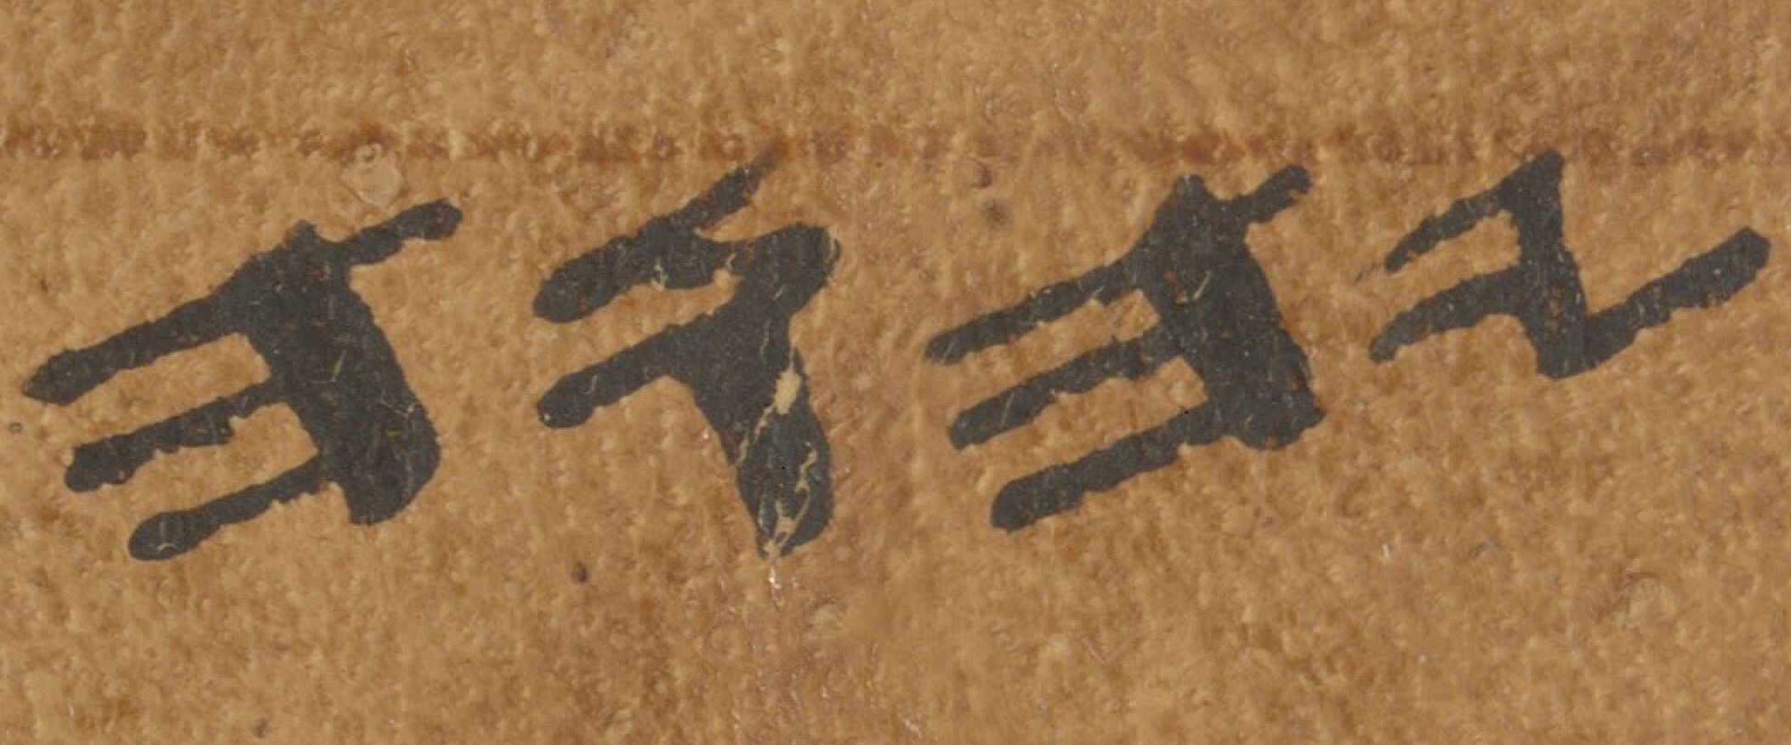
Hebrews 5:8-10
2
8 Although He was a Son, He learned obedience from the things which He suffered.
9 And having been made perfect, He became to all those who obey Him the source of eternal salvation,
10 being designated by God as a high priest according to the order of Melchizedek.
What do we know about the order of Melchizedek?
Almost nothing at all. So why does Hebrews present it as a glorfied position? How are we to understand it as such if we have little idea of what this preiesthood is?
This is the Hebrew Tetragrammatron, or divine name “YHWH” as written on Paleo-Hebrew on scroll 11Q5. The Great Psalms Scroll

Slide 3
Luke 4:16-21
3
16 And He came to Nazareth, where He had been brought up; and as was His custom, He entered the synagogue on the Sabbath, and stood up to read.
17 And the book of the prophet Isaiah was handed to Him. And He opened the book and found the place where it was written,
18 "THE SPIRIT OF THE LORD IS UPON ME, BECAUSE HE ANOINTED ME TO PREACH THE GOSPEL TO THE POOR. HE HAS SENT ME TO PROCLAIM RELEASE TO THE CAPTIVES, AND RECOVERY OF SIGHT TO THE BLIND, TO SET FREE THOSE WHO ARE OPPRESSED,
19 TO PROCLAIM THE FAVORABLE YEAR OF THE LORD."
20 And He closed the book, gave it back to the attendant and sat down; and the eyes of all in the synagogue were fixed on Him.
21 And He began to say to them, "Today this Scripture has been fulfilled in your hearing."

Slide 4
Luke 4:16-21
4
16 And He came to Nazareth, where He had been brought up; and as was His custom, He entered the synagogue on the Sabbath, and stood up to read.
17 And the book of the prophet Isaiah was handed to Him. And He opened the book and found the place where it was written,
18 "THE SPIRIT OF THE LORD IS UPON ME, BECAUSE HE ANOINTED ME TO PREACH THE GOSPEL TO THE POOR. HE HAS SENT ME TO PROCLAIM RELEASE TO THE CAPTIVES, AND RECOVERY OF SIGHT TO THE BLIND, TO SET FREE THOSE WHO ARE OPPRESSED,
19 TO PROCLAIM THE FAVORABLE YEAR OF THE LORD."
20 And He closed the book, gave it back to the attendant and sat down; and the eyes of all in the synagogue were fixed on Him.
21 And He began to say to them, "Today this Scripture has been fulfilled in your hearing."
Verse 18 is quoting Isiah 61:2 where the Tetragrammatron is used. Yet in scroll 11Q5, the The Great Psalms Scroll, when quoting this same passage, they use Melchizedek instead of YHWH. They considered them interchangable terms.

Slide 5
Hebrews 8:1-3
5
1 Now the main point in what has been said [is this]: we have such a high priest, who has taken His seat at the right hand of the throne of the Majesty in the heavens,
2 a minister in the sanctuary and in the true tabernacle, which the Lord pitched, not man.
3 For every high priest is appointed to offer both gifts and sacrifices; so it is necessary that this [high priest] also have something to offer.

Slide 6
Hebrews 8:4-6
6
4 Now if He were on earth, He would not be a priest at all, since there are those who offer the gifts according to the Law;
5 who serve a copy and shadow of the heavenly things, just as Moses was warned [by God] when he was about to erect the tabernacle; for, "SEE," He says, "THAT YOU MAKE all things ACCORDING TO THE PATTERN WHICH WAS SHOWN YOU ON THE MOUNTAIN."
6 But now He has obtained a more excellent ministry, by as much as He is also the mediator of a better covenant, which has been enacted on better promises.

Slide 7
Hebrews 8:4-6
7
4 Now if He were on earth, He would not be a priest at all, since there are those who offer the gifts according to the Law;
5 who serve a copy and shadow of the heavenly things, just as Moses was warned [by God] when he was about to erect the tabernacle; for, "SEE," He says, "THAT YOU MAKE all things ACCORDING TO THE PATTERN WHICH WAS SHOWN YOU ON THE MOUNTAIN."
6 But now He has obtained a more excellent ministry, by as much as He is also the mediator of a better covenant, which has been enacted on better promises.
Galatians 3:19
Duel Mediators
Why the Law then? It was added because of transgressions, having been ordained through angels by the agency of a mediator, (Moses) until the seed would come to whom the promise had been made.

Slide 8
Hebrews 8:4-6
8
4 Now if He were on earth, He would not be a priest at all, since there are those who offer the gifts according to the Law;
5 who serve a copy and shadow of the heavenly things, just as Moses was warned [by God] when he was about to erect the tabernacle; for, "SEE," He says, "THAT YOU MAKE all things ACCORDING TO THE PATTERN WHICH WAS SHOWN YOU ON THE MOUNTAIN."
6 But now He has obtained a more excellent ministry, by as much as He is also the mediator of a better covenant, which has been enacted on better promises.
Galatians 3:19
Why the Law then? It was added because of transgressions, having been ordained through angels by the agency of a mediator, (Moses) until the seed would come to whom the promise had been made.
Galatians 3:16
Now the promises were spoken to Abraham and to his seed. He does not say, "And to seeds," as [referring] to many, but [rather] to one, "And to your seed," that is, Christ.

Slide 9
Hebrews 8:4-6
9
4 Now if He were on earth, He would not be a priest at all, since there are those who offer the gifts according to the Law;
5 who serve a copy and shadow of the heavenly things, just as Moses was warned [by God] when he was about to erect the tabernacle; for, "SEE," He says, "THAT YOU MAKE all things ACCORDING TO THE PATTERN WHICH WAS SHOWN YOU ON THE MOUNTAIN."
6 But now He has obtained a more excellent ministry, by as much as He is also the mediator of a better covenant, which has been enacted on better promises.
1 Timothy 1:5
For there is one God, [and] one mediator also between God and men, [the] man Christ Jesus

Slide 10
What are these verses talking about?
10
25 As He says also in Hosea, "I WILL CALL THOSE WHO WERE NOT MY PEOPLE, 'MY PEOPLE,' AND HER WHO WAS NOT BELOVED, 'BELOVED.'"
26 "AND IT SHALL BE THAT IN THE PLACE WHERE IT WAS SAID TO THEM, 'YOU ARE NOT MY PEOPLE,' THERE THEY SHALL BE CALLED SONS OF THE LIVING GOD."

Slide 11
What are these verses talking about?
11
24 [even] us, whom He also called, not from among Jews only, but also from among Gentiles.
25 As He says also in Hosea, "I WILL CALL THOSE WHO WERE NOT MY PEOPLE, 'MY PEOPLE,' AND HER WHO WAS NOT BELOVED, 'BELOVED.'"
26 "AND IT SHALL BE THAT IN THE PLACE WHERE IT WAS SAID TO THEM, 'YOU ARE NOT MY PEOPLE,' THERE THEY SHALL BE CALLED SONS OF THE LIVING GOD."

Slide 12
What are these verses talking about?
12
22 What if God, although willing to demonstrate His wrath and to make His power known, endured with much patience vessels of wrath prepared for destruction?
23 And [He did so] to make known the riches of His glory upon vessels of mercy, which He prepared beforehand for glory,
24 [even] us, whom He also called, not from among Jews only, but also from among Gentiles.
25 As He says also in Hosea, "I WILL CALL THOSE WHO WERE NOT MY PEOPLE, 'MY PEOPLE,' AND HER WHO WAS NOT BELOVED, 'BELOVED.'"
26 "AND IT SHALL BE THAT IN THE PLACE WHERE IT WAS SAID TO THEM, 'YOU ARE NOT MY PEOPLE,' THERE THEY SHALL BE CALLED SONS OF THE LIVING GOD."

Slide 13
Romans 9:21-26
13
21 Or does not the potter have a right over the clay, to make from the same lump one vessel for honorable use and another for common use?
22 What if God, although willing to demonstrate His wrath and to make His power known, endured with much patience vessels of wrath prepared for destruction?
23 And [He did so] to make known the riches of His glory upon vessels of mercy, which He prepared beforehand for glory,
24 [even] us, whom He also called, not from among Jews only, but also from among Gentiles.
25 As He says also in Hosea, "I WILL CALL THOSE WHO WERE NOT MY PEOPLE, 'MY PEOPLE,' AND HER WHO WAS NOT BELOVED, 'BELOVED.'"
26 "AND IT SHALL BE THAT IN THE PLACE WHERE IT WAS SAID TO THEM, 'YOU ARE NOT MY PEOPLE,' THERE THEY SHALL BE CALLED SONS OF THE LIVING GOD."

Slide 14
Hebrews 8:7-9
14
7 For if that first [covenant] had been faultless, there would have been no occasion sought for a second.
8 For finding fault with them, He says, "BEHOLD, DAYS ARE COMING, SAYS THE LORD, WHEN I WILL EFFECT A NEW COVENANT WITH THE HOUSE OF ISRAEL AND WITH THE HOUSE OF JUDAH;
9 NOT LIKE THE COVENANT WHICH I MADE WITH THEIR FATHERS ON THE DAY WHEN I TOOK THEM BY THE HAND TO LEAD THEM OUT OF THE LAND OF EGYPT; FOR THEY DID NOT CONTINUE IN MY COVENANT, AND I DID NOT CARE FOR THEM, SAYS THE LORD.

Slide 15
Hebrews 8:7-9
15
Replacement Theology (Supersessionism):
Asserts that because ethnic Israel rejected Jesus as the Messiah, God rejected the nation, revoked His original national promises, and transferred them entirely to the Christian church. Under this view, national Israel has no future role in divine redemptive history. Must accept Christ as Savior.
Dual Covenant Theology:
The belief that Jewish people have a separate, valid path to God through the Mosaic covenant without needing Christ. May accept Christ or be a practicing Jew for salvation.
7 For if that first [covenant] had been faultless, there would have been no occasion sought for a second.
8 For finding fault with them, He says, "BEHOLD, DAYS ARE COMING, SAYS THE LORD, WHEN I WILL EFFECT A NEW COVENANT WITH THE HOUSE OF ISRAEL AND WITH THE HOUSE OF JUDAH;
9 NOT LIKE THE COVENANT WHICH I MADE WITH THEIR FATHERS ON THE DAY WHEN I TOOK THEM BY THE HAND TO LEAD THEM OUT OF THE LAND OF EGYPT; FOR THEY DID NOT CONTINUE IN MY COVENANT, AND I DID NOT CARE FOR THEM, SAYS THE LORD.

Slide 16
Hebrews 8:7-9
16
Covenant Theology:
Emphasizes continuity between ethnic Israel and the New Testament Church, viewing the Church as the fulfillment and continuation of God's ancient people. Salvation is through Christ!
Dispensationalism:
Emphasizes a distinct separation between Israel and the Church, maintaining that God has separate, distinct future promises and earthly plans remaining for national Israel. BUT they must accept Christ to be saved!
7 For if that first [covenant] had been faultless, there would have been no occasion sought for a second.
8 For finding fault with them, He says, "BEHOLD, DAYS ARE COMING, SAYS THE LORD, WHEN I WILL EFFECT A NEW COVENANT WITH THE HOUSE OF ISRAEL AND WITH THE HOUSE OF JUDAH;
9 NOT LIKE THE COVENANT WHICH I MADE WITH THEIR FATHERS ON THE DAY WHEN I TOOK THEM BY THE HAND TO LEAD THEM OUT OF THE LAND OF EGYPT; FOR THEY DID NOT CONTINUE IN MY COVENANT, AND I DID NOT CARE FOR THEM, SAYS THE LORD.

Slide 17
Hebrews 8:7-9
17
7 For if that first [covenant] had been faultless, there would have been no occasion sought for a second.
8 For finding fault with them, He says, "BEHOLD, DAYS ARE COMING, SAYS THE LORD, WHEN I WILL EFFECT A NEW COVENANT WITH THE HOUSE OF ISRAEL AND WITH THE HOUSE OF JUDAH;
9 NOT LIKE THE COVENANT WHICH I MADE WITH THEIR FATHERS ON THE DAY WHEN I TOOK THEM BY THE HAND TO LEAD THEM OUT OF THE LAND OF EGYPT; FOR THEY DID NOT CONTINUE IN MY COVENANT, AND I DID NOT CARE FOR THEM, SAYS THE LORD. (Jeremiah 31:31-32 586 and 570 BC)

Slide 18
Hebrews 8:7-9
18
7 For if that first [covenant] had been faultless, there would have been no occasion sought for a second.
8 For finding fault with them, He says, "BEHOLD, DAYS ARE COMING, SAYS THE LORD, WHEN I WILL EFFECT A NEW COVENANT WITH THE HOUSE OF ISRAEL AND WITH THE HOUSE OF JUDAH;
9 NOT LIKE THE COVENANT WHICH I MADE WITH THEIR FATHERS ON THE DAY WHEN I TOOK THEM BY THE HAND TO LEAD THEM OUT OF THE LAND OF EGYPT; FOR THEY DID NOT CONTINUE IN MY COVENANT, AND I DID NOT CARE FOR THEM, SAYS THE LORD.
◄ 272. ameleó ►
Quoting Jeremiah 31:32, the writer describes the Lord’s judicial response to Israel’s persistent unfaithfulness. Neglect appears on God’s side—not as moral failure but as judicial abandonment after repeated covenant breaches. The contrast sharpens the superiority of the new covenant, secured by Christ’s better priesthood and internalized law.

Slide 19
Hebrews 8:7-9
19
7 For if that first [covenant] had been faultless, there would have been no occasion sought for a second.
8 For finding fault with them, He says, "BEHOLD, DAYS ARE COMING, SAYS THE LORD, WHEN I WILL EFFECT A NEW COVENANT WITH THE HOUSE OF ISRAEL AND WITH THE HOUSE OF JUDAH;
9 NOT LIKE THE COVENANT WHICH I MADE WITH THEIR FATHERS ON THE DAY WHEN I TOOK THEM BY THE HAND TO LEAD THEM OUT OF THE LAND OF EGYPT; FOR THEY DID NOT CONTINUE IN MY COVENANT, AND I DID NOT CARE FOR THEM, SAYS THE LORD.

Slide 20
Hebrews 8:7-9
20
7 For if that first [covenant] had been faultless, there would have been no occasion sought for a second.
8 For finding fault with them, He says, "BEHOLD, DAYS ARE COMING, SAYS THE LORD, WHEN I WILL EFFECT A NEW COVENANT WITH THE HOUSE OF ISRAEL AND WITH THE HOUSE OF JUDAH;
9 NOT LIKE THE COVENANT WHICH I MADE WITH THEIR FATHERS ON THE DAY WHEN I TOOK THEM BY THE HAND TO LEAD THEM OUT OF THE LAND OF EGYPT; FOR THEY DID NOT CONTINUE IN MY COVENANT, AND I DID NOT CARE FOR THEM, SAYS THE LORD.

Slide 21
Hebrews 8:7-9
21
Covenant Theology:
Emphasizes continuity between ethnic Israel and the New Testament Church, viewing the Church as the fulfillment and continuation of God's ancient people. Salvation is through Christ!
Dispensationalism:
Emphasizes a distinct separation between Israel and the Church, maintaining that God has separate, distinct future promises and earthly plans remaining for national Israel. BUT they must accept Christ to be saved!
7 For if that first [covenant] had been faultless, there would have been no occasion sought for a second.
8 For finding fault with them, He says, "BEHOLD, DAYS ARE COMING, SAYS THE LORD, WHEN I WILL EFFECT A NEW COVENANT WITH THE HOUSE OF ISRAEL AND WITH THE HOUSE OF JUDAH;
9 NOT LIKE THE COVENANT WHICH I MADE WITH THEIR FATHERS ON THE DAY WHEN I TOOK THEM BY THE HAND TO LEAD THEM OUT OF THE LAND OF EGYPT; FOR THEY DID NOT CONTINUE IN MY COVENANT, AND I DID NOT CARE FOR THEM, SAYS THE LORD.

Slide 22
Hebrews 8:7-9
22
7 For if that first [covenant] had been faultless, there would have been no occasion sought for a second.
8 For finding fault with them, He says, "BEHOLD, DAYS ARE COMING, SAYS THE LORD, WHEN I WILL EFFECT A NEW COVENANT WITH THE HOUSE OF ISRAEL AND WITH THE HOUSE OF JUDAH;
9 NOT LIKE THE COVENANT WHICH I MADE WITH THEIR FATHERS ON THE DAY WHEN I TOOK THEM BY THE HAND TO LEAD THEM OUT OF THE LAND OF EGYPT; FOR THEY DID NOT CONTINUE IN MY COVENANT, AND I DID NOT CARE FOR THEM, SAYS THE LORD.
Romans 1:16
For I am not ashamed of the gospel, for it is the power of God for salvation to everyone who believes, to the Jew first and also to the Greek.

Slide 23
Hebrews 8:10-12
23
10 "FOR THIS IS THE COVENANT THAT I WILL MAKE WITH THE HOUSE OF ISRAEL AFTER THOSE DAYS, SAYS THE LORD: I WILL PUT MY LAWS INTO THEIR MINDS, AND I WILL WRITE THEM ON THEIR HEARTS. AND I WILL BE THEIR GOD, AND THEY SHALL BE MY PEOPLE.
11 "AND THEY SHALL NOT TEACH EVERYONE HIS FELLOW CITIZEN, AND EVERYONE HIS BROTHER, SAYING, 'KNOW THE LORD,' FOR ALL WILL KNOW ME, FROM THE LEAST TO THE GREATEST OF THEM.
12 "FOR I WILL BE MERCIFUL TO THEIR INIQUITIES, AND I WILL REMEMBER THEIR SINS NO MORE.". (Jeremiah 31:33)

Slide 24
Hebrews 8:10-12
24
10 "FOR THIS IS THE COVENANT THAT I WILL MAKE WITH THE HOUSE OF ISRAEL AFTER THOSE DAYS, SAYS THE LORD: I WILL PUT MY LAWS INTO THEIR MINDS, AND I WILL WRITE THEM ON THEIR HEARTS. AND I WILL BE THEIR GOD, AND THEY SHALL BE MY PEOPLE.
11 "AND THEY SHALL NOT TEACH EVERYONE HIS FELLOW CITIZEN, AND EVERYONE HIS BROTHER, SAYING, 'KNOW THE LORD,' FOR ALL WILL KNOW ME, FROM THE LEAST TO THE GREATEST OF THEM.
12 "FOR I WILL BE MERCIFUL TO THEIR INIQUITIES, AND I WILL REMEMBER THEIR SINS NO MORE.". (Jeremiah 31:33)

Slide 25
Hebrews 8:13
25
13 When He said, "A new [covenant]," He has made the first obsolete. But whatever is becoming obsolete and growing old is ready to disappear.

Slide 26
Hebrews 9:1-4
26
1 Now even the first [covenant] had regulations of divine worship and the earthly sanctuary.
2 For there was a tabernacle prepared, the outer one, in which [were] the lampstand and the table and the sacred bread; this is called the holy place.
3 Behind the second veil there was a tabernacle which is called the Holy of Holies,
4 having a golden altar of incense and the ark of the covenant covered on all sides with gold, in which was a golden jar holding the manna, and Aaron's rod which budded, and the tables of the covenant;

Slide 27
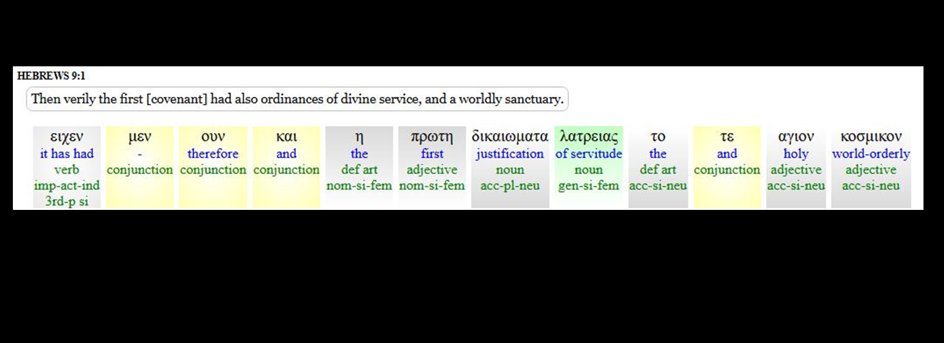
Hebrews 9:1-4
27
1 Now even the first [covenant] had regulations of divine worship and the earthly sanctuary.
2 For there was a tabernacle prepared, the outer one, in which [were] the lampstand and the table and the sacred bread; this is called the holy place.
3 Behind the second veil there was a tabernacle which is called the Holy of Holies,
4 having a golden altar of incense and the ark of the covenant covered on all sides with gold, in which was a golden jar holding the manna, and Aaron's rod which budded, and the tables of the covenant;

Slide 28
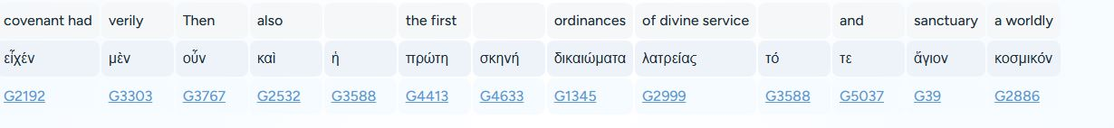
Hebrews 9:1-4
28
1 Now even the first [covenant] had regulations of divine worship and the earthly sanctuary.
2 For there was a tabernacle prepared, the outer one, in which [were] the lampstand and the table and the sacred bread; this is called the holy place.
3 Behind the second veil there was a tabernacle which is called the Holy of Holies,
4 having a golden altar of incense and the ark of the covenant covered on all sides with gold, in which was a golden jar holding the manna, and Aaron's rod which budded, and the tables of the covenant;

Slide 29
Hebrews 11
29
17 By faith Abraham, when he was tested, offered up Isaac, and he who had received the promises was offering up his only begotten [son];
23 By faith Moses, when he was born, was hidden for three months by his parents, because they saw he was a beautiful child; and they were not afraid of the king's edict.
24 By faith Moses, when he had grown up, refused to be called the son of Pharaoh's daughter,
28 By faith he kept the Passover and the sprinkling of the blood

Slide 30
Hebrews 11
30
29 By faith they passed through the Red Sea as though [they were passing] through dry land; and the Egyptians, when they attempted it, were drowned.
30 By faith the walls of Jericho fell down after they had been encircled for seven days.
31 By faith Rahab the harlot did not perish along with those who were disobedient, after she had welcomed the spies in peace.
32 And what more shall I say? For time will fail me if I tell of Gideon, Barak, Samson, Jephthah, of David and Samuel and the prophets,
33 who by faith

Slide 31
Hebrews 9:1-4
31
1 Now even the first [covenant] had regulations of divine worship and the earthly sanctuary.
2 For there was a tabernacle prepared, the outer one, in which [were] the lampstand and the table and the sacred bread; this is called the holy place.
3 Behind the second veil there was a tabernacle which is called the Holy of Holies,
4 having a golden altar of incense and the ark of the covenant covered on all sides with gold, in which was a golden jar holding the manna, and Aaron's rod which budded, and the tables of the covenant;

Slide 32
Hebrews 9:5-8
32
5 and above it [were] the cherubim of glory overshadowing the mercy seat; but of these things we cannot now speak in detail.
6 Now when these things have been so prepared, the priests are continually entering the outer tabernacle performing the divine worship,
7 but into the second, only the high priest [enters] once a year, not without [taking] blood, which he offers for himself and for the sins of the people committed in ignorance.
8 The Holy Spirit [is] signifying this, that the way into the holy place has not yet been disclosed while the outer tabernacle is still standing,

Slide 33
Hebrews 9:9-12
33
9 which [is] a symbol for the present time. Accordingly both gifts and sacrifices are offered which cannot make the worshiper perfect in conscience,
10 since they [relate] only to food and drink and various washings, regulations for the body imposed until a time of reformation.
11 But when Christ appeared [as] a high priest of the good things to come, [He entered] through the greater and more perfect tabernacle, not made with hands, that is to say, not of this creation;
12 and not through the blood of goats and calves, but through His own blood, He entered the holy place once for all, having obtained eternal redemption.

Slide 34
Hebrews 9:9-15
34
13 For if the blood of goats and bulls and the ashes of a heifer sprinkling those who have been defiled sanctify for the cleansing of the flesh,
14 how much more will the blood of Christ, who through the eternal Spirit offered Himself without blemish to God, cleanse your conscience from dead works to serve the living God?
15 For this reason He is the mediator of a new covenant, so that, since a death has taken place for the redemption of the transgressions that were [committed] under the first covenant, those who have been called may receive the promise of the eternal inheritance.

