Slide 1

1
WEEK 1
2-22-26

Slide 2

james
2

Slide 3
I Corinthians 15:5-8
3
5 and that He appeared to Cephas, then to the twelve.
6 After that He appeared to more than five hundred brethren at one time, most of whom remain until now, but some have fallen asleep;
7 then He appeared to James, then to all the apostles;
8 and last of all, as to one untimely born, He appeared to me also.

Slide 4
I Corinthians 15:5-8
4
5 and that He appeared to Cephas, then to the twelve.
6 After that He appeared to more than five hundred brethren at one time, most of whom remain until now, but some have fallen asleep;
7 then He appeared to James, then to all the apostles;
8 and last of all, as to one untimely born, He appeared to me also.
Why was the appearance to James noted after the appearance to so many others?

Slide 5
Galatians 1:18-19
5
18 Then three years later I went up to Jerusalem to become acquainted with Cephas, and stayed with him for fifteen days.
19 But I did not see another one of the apostles except James, the Lord’s brother.
This was about 36 or 37AD, and James, the brother of Jesus, was already a leader. However, he became the primary leader of the Jerusalem church around 44 AD. His rise to leadership was solidified following the martyrdom of James the son of Zebedee and the departure of Peter from Jerusalem. He was recognized as a leading apostle and a "pillar" of the church, presiding over the Council of Jerusalem in 50 AD.

Slide 6
Acts 12:1-5
6
1 Now about that time Herod the king laid hands on some who belonged to the church, to do them harm.
2 And he had James the brother of John executed with a sword.
3 When he saw that it pleased the Jews, he proceeded to arrest Peter as well. (Now these were the days of Unleavened Bread.)
4 When he had arrested him, he put him in prison, turning him over to four squads of soldiers to guard him, intending only after the Passover to bring him before the people.
5 So Peter was kept in the prison, but prayer for him was being made to God intensely by the church.

Slide 7
Acts 12:6-9
7
6 On [e]the very night when Herod was about to bring him forward, Peter was sleeping between two soldiers, bound with two chains, and guards in front of the door were watching over the prison.
7 And behold, an angel of the Lord suddenly stood near Peter, and a light shone in the cell; and he struck Peter’s side and woke him, saying, “Get up quickly.” And his chains fell off his hands.
8 And the angel said to him, “Put on your belt and [f]strap on your sandals.” And he did so. And he *said to him, “Wrap your cloak around you and follow me.”
9 And he went out and continued to follow, and yet he did not know that what was being done by the angel was real, but thought he was seeing a vision.

Slide 8
Acts 12:10-11
8
10 Now when they had passed the first and second guard, they came to the iron gate that leads into the city, which opened for them by itself; and they went out and went along one street, and immediately the angel departed from him.
11 When Peter came to himself, he said, “Now I know for sure that the Lord has sent forth His angel and rescued me from the hand of Herod and from all that the Jewish people were expecting.

Slide 9
Acts 12:18-19
9
18 Now when day came, there was no small disturbance among the soldiers as to what could have become of Peter.
19 When Herod had searched for him and had not found him, he examined the guards and ordered that they be led away to execution. Then he went down from Judea to Caesarea and was spending time there.

Slide 10
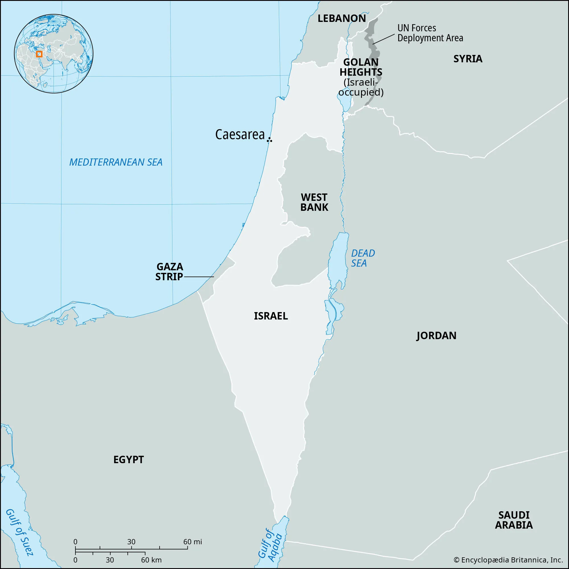
caesarea
10

Slide 11
Acts 12:18-19
11
Ananus ben Ananus took advantage of the power vacuum in Judea, specifically the interval between the death of Roman procurator Festus and the arrival of his replacement, Albinus, in 62 AD to kill James the Just. Leveraging his position as high priest, Ananus convened a Sanhedrin to condemn James for violating the law
According to tradition and historian Josephus, he was stoned to death on the orders of High Priest Ananus ben Ananus, or, alternatively, thrown from the Temple pinnacle and beaten to death.
Josephus tells of the death of James in his work Antiquities of the Jews, specifically Book 20, Chapter 9, Section 1

Slide 12
Acts 15:13 &19-21
12
13 After they had stopped speaking, James answered, saying, "Brethren, listen to me.
19 "Therefore it is my judgment that we do not trouble those who are turning to God from among the Gentiles,
20 but that we write to them that they abstain from things contaminated by idols and from fornication and from what is strangled and from blood.
21 "For Moses from ancient generations has in every city those who preach him, since he is read in the synagogues every Sabbath."

Slide 13
James 1:1 & 12
13
1James, a bond-servant of God and of the Lord Jesus Christ, To the twelve tribes who are dispersed abroad: Greetings.

Slide 14
James 2:14-17
14
14 What use is it, my brethren, if someone says he has faith but he has no works? Can that faith save him?
15 If a brother or sister is without clothing and in need of daily food,
16 and one of you says to them, "Go in peace, be warmed and be filled," and yet you do not give them what is necessary for [their] body, what use is that?
17 Even so faith, if it has no works, is dead, [being] by itself.

Slide 15
Justified by faith?
15
Romans 5:1
Therefore, having been justified by faith, we have peace with God through our Lord Jesus Christ.
Galatians 3:23-24
23 But before faith came, we were kept in custody under the law, being shut up to the faith which was later to be revealed. 24 Therefore the Law has become our tutor to lead us to Christ, so that we may be justified by faith.
Romans 3:28
For we maintain that a person is justified by faith apart from works of the Law.

Slide 16
Justified by faith?
16
Galatians 2:16
16 nevertheless, knowing that a person is not justified by works of [m]the Law but through faith in Christ Jesus, even we have believed in Christ Jesus, so that we may be justified by faith in Christ and not by works of [n]the Law; since by works of [o]the Law no [p]flesh will be justified
Romans 3:28
For we maintain that a person is justified by faith apart from works of the Law.

Slide 17
James 2:24-26
17
24 You see that a man is justified by works and not by faith alone.
25 In the same way, was not Rahab the harlot also justified by works when she received the messengers and sent them out by another way?
26 For just as the body without [the] spirit is dead, so also faith without works is dead.

Slide 18
Dr. john Lennox
18
President of OCCA (The Oxford Centre for Christian Apologetics). He also teaches science and religion in the University of Oxford.
Lennox earned a doctorate in mathematics from the University of Cambridge, followed by second and third doctorates from the University of Oxford and Cardiff University, respectively. He is emeritus professor of Mathematics at the University of Oxford, where he is also Emeritus Fellow in Mathematics and Philosophy of Science at Green Templeton College, and has worked as adjunct lecturer at Wycliffe Hall and at the Oxford Centre for Christian Apologetics. He is also an Associate Fellow of the Saïd Business School and a Senior Fellow at the Trinity Forum.

Slide 19
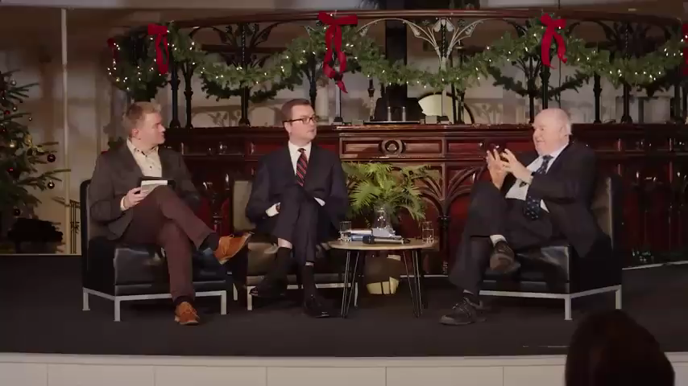
Dr. John Lennox
19

Slide 20

Marriage
20

