Slide 1

1
WEEK 2
3-1-26

Slide 2
James 1:1-5
2
1 James, a bond-servant of God and of the Lord Jesus Christ, To the twelve tribes who are dispersed abroad: Greetings.
2 Consider it all joy, my brethren, when you encounter various trials,
3 knowing that the testing of your faith produces endurance.
4 And let endurance have [its] perfect result, so that you may be perfect and complete, lacking in nothing.
5 But if any of you lacks wisdom, let him ask of God, who gives to all generously and without reproach, and it will be given to him.
Why Ask?

Slide 3
James 1
3
Someone might not ask God for wisdom due to pride, self-reliance, doubt, or a lack of understanding regarding their own need for it. It requires admitting limitations and surrendering control, which can be difficult. Others may lack faith, doubt God's willingness to give, or fail to recognize their need.

Slide 4
James 1:6-8
4
Someone might not ask God for wisdom due to pride, self-reliance, doubt, or a lack of understanding regarding their own need for it. It requires admitting limitations and surrendering control, which can be difficult. Others may lack faith, doubt God's willingness to give, or fail to recognize their need.
6 But he must ask in faith without any doubting, for the one who doubts is like the surf of the sea, driven and tossed by the wind.
7 For that man ought not to expect that he will receive anything from the Lord,
8 [being] a double-minded man, unstable in all his ways.

Slide 5
James 1:9-11
5
9 But the brother of humble circumstances is to glory in his high position;
10 and the rich man [is to glory] in his humiliation, because like flowering grass he will pass away.
11 For the sun rises with a scorching wind and withers the grass; and its flower falls off and the beauty of its appearance is destroyed; so too the rich man in the midst of his pursuits will fade away.

Slide 6

Screwtape letter #20
6

Slide 7
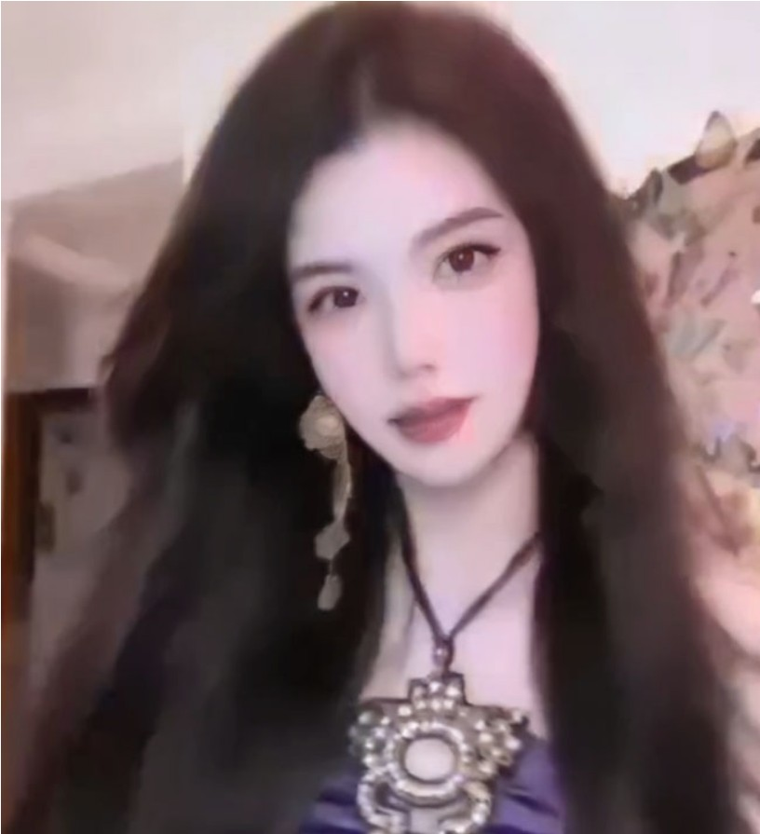
Chinese Beauty Influencer
7

Slide 8
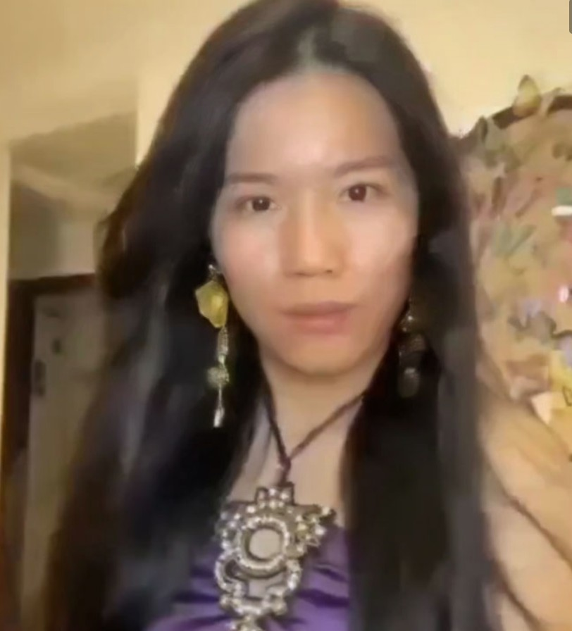
Lost 140,00 subscribers
8

Slide 9
9
he will receive which [the Lord] has promised to those who love Him.

Slide 10
10
he will receive which [the Lord] has promised to those who love Him.
What has God promised to those that love Him?

Slide 11
11
he will receive the crown of life which [the Lord] has promised to those who love Him.

Slide 12
James 1
12
he will receive the crown of life which [the Lord] has promised to those who love Him.
Ephesus
Rev 2:7 He who has an ear, let him hear what the Spirit says to the churches. To him who overcomes, I will grant to eat of the tree of life which is in the Paradise of God.
Smyrna
Rev 2:11 He who has an ear, let him hear what the Spirit says to the churches. He who overcomes will not be hurt by the second death.'

Slide 13
James 1
13
he will receive the crown of life which [the Lord] has promised to those who love Him.
Smyrna
Rev 2:10 Do not fear what you are about to suffer. Behold, the devil is about to cast some of you into prison, so that you will be tested, and you will have tribulation for ten days. Be faithful until death, and I will give you the crown of life.
Rev 2:11 He who has an ear, let him hear what the Spirit says to the churches. He who overcomes will not be hurt by the second death.'

Slide 14
James 1:12
14
12 Blessed is a man who perseveres under trial; for once he has been approved, he will receive the crown of life which [the Lord] has promised to those who love Him.
1384 dókimos (an adjective, derived from 1209/dexomai, "to receive, welcome") – properly, what passes the necessary test (scrutiny); hence acceptable because genuine (validated, verified).

Slide 15
James 1:12-15
15
12 Blessed is a man who perseveres under trial; for once he has been approved, he will receive the crown of life which [the Lord] has promised to those who love Him.
13 Let no one say when he is tempted, "I am being tempted by God"; for God cannot be tempted by evil, and He Himself does not tempt anyone.
14 But each one is tempted when he is carried away and enticed by his own lust.
15 Then when lust has conceived, it gives birth to sin; and when sin is accomplished, it brings forth death.

Slide 16
James 1:14-18
16
14 But each one is tempted when he is carried away and enticed by his own lust.
15 Then when lust has conceived, it gives birth to sin; and when sin is accomplished, it brings forth death.
16 Do not be deceived, my beloved brethren.
17 Every good thing given and every perfect gift is from above, coming down from the Father of lights, with whom there is no variation or shifting shadow.
18 In the exercise of His will He brought us forth by the word of truth, so that we would be a kind of first fruits among His creatures

Slide 17
James 1:19-22
17
19 [This] you know, my beloved brethren. But everyone must be quick to hear, slow to speak [and] slow to anger;
20 for the anger of man does not achieve the righteousness of God.
21 Therefore, putting aside all filthiness and [all] that remains of wickedness, in humility receive the word implanted, which is able to save your souls.
22 But prove yourselves doers of the word, and not merely hearers who delude themselves.

Slide 18
James 1:23-26
18
23 For if anyone is a hearer of the word and not a doer, he is like a man who looks at his natural face in a mirror;
24 for [once] he has looked at himself and gone away, he has immediately forgotten what kind of person he was.
25 But one who looks intently at the perfect law, the [law] of liberty, and abides by it, not having become a forgetful hearer but an effectual doer, this man will be blessed in what he does.
26 If anyone thinks himself to be religious, and yet does not bridle his tongue but deceives his [own] heart, this man's religion is worthless.

Slide 19
James 1:27
19
27 Pure and undefiled religion in the sight of [our] God and Father is this: to visit orphans and widows in their distress, [and] to keep oneself unstained by the world.

Slide 20

The Sneeze
20

