Slide 1

1
WEEK 5
3-29-26

Slide 2
James 2:14-17
2
14 What use is it, my brethren, if someone says he has faith but he has no works? Can that faith save him?
15 If a brother or sister is without clothing and in need of daily food,
16 and one of you says to them, "Go in peace, be warmed and be filled," and yet you do not give them what is necessary for [their] body, what use is that?
17 Even so faith, if it has no works, is dead, [being] by itself.

Slide 3
Doctrine of grace
3
John Calvin (1509–1564)argued that while humans possess a voluntary will, it is in total bondage to sin after the Fall, rendering it incapable of choosing to follow God without sovereign grace.

Slide 4
Irresistible grace
4
John Calvin (1509–1564)argued that while humans possess a voluntary will, it is in total bondage to sin after the Fall, rendering it incapable of choosing to follow God without sovereign grace.
In other words, you have free will, but you are to sinful to ever choose Christ.

Slide 5
Matthew 7:9-11
5
9 Or what person is there among you who, when his son asks for a loaf of bread, will give him a stone?
10 Or if he asks for a fish, he will not give him a snake, will he?
11 So if you, despite being evil, know how to give good gifts to your children, how much more will your Father who is in heaven give good things to those who ask Him!

Slide 6
Doctrine of grace
6
Jacobus Arminius (1560–1609) defined prevenient grace as the supernatural, enabling work of the Holy Spirit that precedes regeneration, restoring human free will to respond to the gospel. This allows sinners to accept or resist God's offer of salvation.

Slide 7
Prevenient grace
7
John 6:44: "No one can come to me unless the Father who sent me draws him".
John 12:32: "And I, when I am lifted up from the earth, will draw all people to myself".
Titus 2:11: "For the grace of God has appeared that offers salvation to all people".
Romans 2:4: "...God’s kindness is intended to lead you to repentance".
John 16:8: "When he [the Holy Spirit] comes, he will convict the world of guilt in regard to sin and righteousness and judgment"

Slide 8
Doctrine of grace
8
Sanctifying grace, in Wesleyan theology, is the enabling work of the Holy Spirit that progressively transforms a justified believer, setting them apart to be holy and restoring them to the image of God. Beginning at the new birth, it cleanses the heart, removes the desire to sin, and empowers perfect love.

Slide 9
Sanctifying grace
9
1 Thessalonians 5:23-24: "May the God of peace himself sanctify you completely..."
Titus 2:11-12: "...the grace of God has appeared... training us to renounce ungodliness... and to live self-controlled, upright, and godly lives".
Romans 6:14: "For sin shall not have dominion over you, for you are not under law but under grace".
Philippians 2:12-13: "...work out your own salvation... for it is God which worketh in you both to will and to do of his good pleasure".
John 17:17: "Sanctify them in the truth; your word is truth".
Hebrews 10:14: "For by a single offering he has perfected for all time those who are being sanctified.

Slide 10
James 2:17-20
10
17 Even so faith, if it has no works, is dead, (nekros) [being] by itself.
18 But someone may [well] say, "You have faith and I have works; show me your faith without the works, and I will show you my faith by my works."
19 You believe that God is one. You do well; the demons also believe, and shudder.
20 But are you willing to recognize, you foolish fellow, that faith without works is useless?
P

Slide 11
James 2:17-20
11
17 Even so faith, if it has no works, is dead, [being] by itself.
18 But someone may [well] say, "You have faith and I have works; show me your faith without the works, and I will show you my faith by my works."
19 You believe that God is one. You do well; the demons also believe, and shudder.
20 But are you willing to recognize, you foolish fellow, that faith without works is useless?
Greco-Roman and Jewish Background
Classical Greek writers used ἀργός (argos)for agricultural land left fallow or laborers shirking their duty. In Jewish wisdom literature idleness was branded folly (Proverbs 6:6-11; Sirach 33:26-29).
The New Testament inherits both streams, treating idleness not merely as social irresponsibility but as moral and spiritual failure.
P

Slide 12
James 3:1-4
12
1 Let not many [of you] become teachers, my brethren, knowing that as such we will incur a stricter judgment.
2 For we all stumble in many [ways]. If anyone does not stumble in what he says, he is a perfect man, able to bridle the whole body as well.
3 Now if we put the bits into the horses' mouths so that they will obey us, we direct their entire body as well.
4 Look at the ships also, though they are so great and are driven by strong winds, are still directed by a very small rudder wherever the inclination of the pilot desires.

Slide 13
James 3:5-7
13
5 So also the tongue is a small part of the body, and [yet] it boasts of great things. See how great a forest is set aflame by such a small fire!
6 And the tongue is a fire, the [very] world of iniquity; the tongue is set among our members as that which defiles the entire body, and sets on fire the course of [our] life, and is set on fire by hell.
7 For every species of beasts and birds, of reptiles and creatures of the sea, is tamed and has been tamed by the human race.

Slide 14
James 3:8-12
14
8 But no one can tame the tongue; [it is] a restless evil [and] full of deadly poison.
9 With it we bless [our] Lord and Father, and with it we curse men, who have been made in the likeness of God;
10 from the same mouth come [both] blessing and cursing. My brethren, these things ought not to be this way.
11 Does a fountain send out from the same opening [both] fresh and bitter [water]?
12 Can a fig tree, my brethren, produce olives, or a vine produce figs? Nor [can] salt water produce fresh.

Slide 15
James 3:13-16
15
13 Who among you is wise and understanding? Let him show by his good behavior his deeds in the gentleness of wisdom.
14 But if you have bitter jealousy and selfish ambition in your heart, do not be arrogant and [so] lie against the truth.
15 This wisdom is not that which comes down from above, but is earthly, natural, demonic.
16 For where jealousy and selfish ambition exist, there is disorder and every evil thing.

Slide 16
James 3:17-18
16
17 But the wisdom from above is first pure, then peaceable, gentle, reasonable, full of mercy and good fruits, unwavering, without hypocrisy.
18 And the seed whose fruit is righteousness is sown in peace by those who make peace.

Slide 17
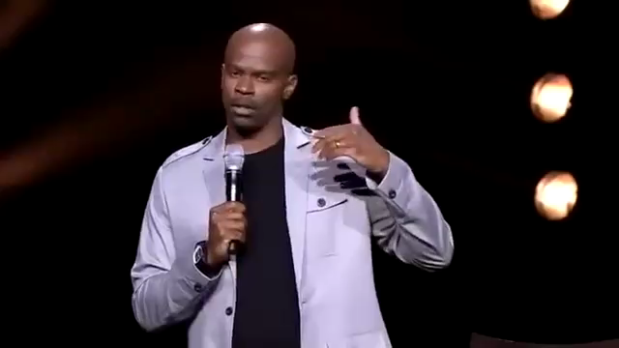
Sanctifying grace
17

