Slide 1
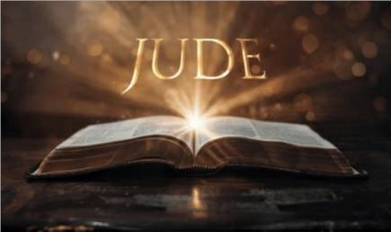
27
WEEK 2
12-14-25

Slide 2
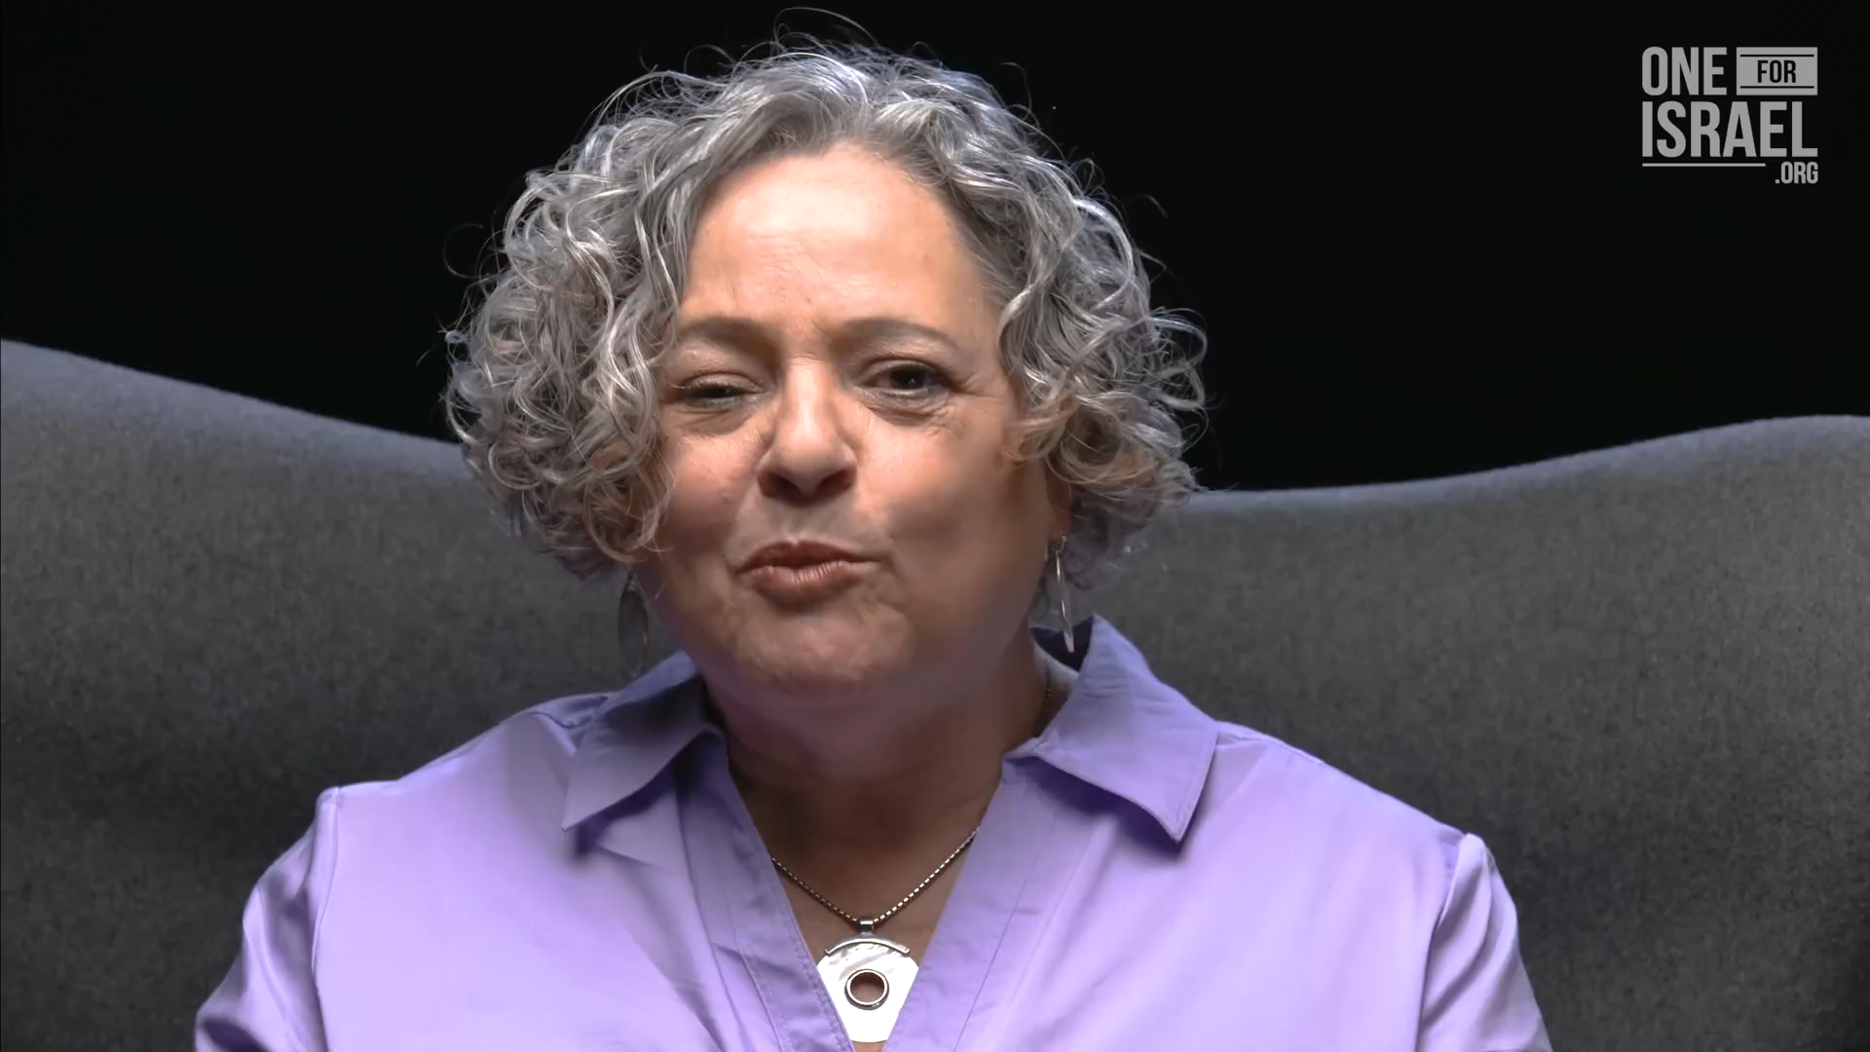
Isaiah revisited
28

Slide 3
Jude
29
6 And angels who did not keep their own domain, but abandoned their proper abode, He has kept in eternal bonds under darkness for the judgment of the great day,

Slide 4
1 Enoch 3
30
1 And it came to pass when the children of men had multiplied that in those days were born unto them beautiful and comely daughters.
2 And the angels, the children of the heaven, saw and lusted after them, and said to one another: "Come, let us choose us wives from among the children of men and beget us children.“
3 And Semjaza, who was their leader, said unto them: "I fear ye will not indeed agree to do this deed, and I alone shall have to pay the penalty of a great sin.“

Slide 5
1 Enoch 3
31
5 Then sware they all together and bound themselves by mutual imprecations upon it. And they were in all two hundred; who descended in the days of Jared on the summit of Mount Hermon, and they called it Mount Hermon, because they had sworn and bound themselves by mutual imprecations upon it.
An imprecation is a spoken or written curse, a strong expression of ill-will, or a prayer calling for misfortune or evil to befall someone or something, essentially wishing harm upon another, often involving a sense of invoking divine or supernatural power. It's a formal, often angry, statement that can range from muttered insults to serious maledictions, and it carries connotations of deep anger or hostility. Luther

Slide 6
Jude
32
6 And angels who did not keep their own domain, but abandoned their proper abode, He has kept in eternal bonds under darkness for the judgment of the great day,
Genesis 6:4
4 There were giants in the earth in those days; and also after that, when the sons of God came in unto the daughters of men, and they bare [children] to them, the same [became] mighty men which [were] of old, men of renown.

Slide 7
1 Enoch 3
33
4 And they all answered him and said: "Let us all swear an oath, and all bind ourselves by mutual imprecations not to abandon this plan but to do this thing.“
5 Then sware they all together and bound themselves by mutual imprecations upon it. And they were in all two hundred; who descended in the days of Jared on the summit of Mount Hermon, and they called it Mount Hermon, because they had sworn and bound themselves by mutual imprecations upon it.
9 And they became pregnant, and they bare great giants….

Slide 8
Enoch 4
34
1 And then Michael, Uriel, Raphael, and Gabriel looked down from heaven and saw much blood being shed upon the earth, and all lawlessness being wrought upon the earth.
They reported to the Lord saying:
6 And they have gone to the daughters of men upon the earth, and have slept with the women, and have defiled themselves, and revealed to them all kinds of sins. And the women have borne giants, and the whole earth has thereby been
filled with blood and unrighteousness. (Jude 6)

Slide 9
1 Enoch 4
35
57 And there mine eyes saw how they made these their instruments, iron chains of immeasurable weight.
58 And I asked the angel of peace who went with me, saying: "For whom are these chains being prepared?“
59 And he said unto me: "These are being prepared for the hosts of Azazel, so that they may take them and cast them into the abyss of complete condemnation,
and they shall cover their jaws with rough stones as the Lord of Spirits commanded."

Slide 10
Jude
36
9 But Michael the archangel, when he disputed with the devil and argued about the body of Moses, did not dare pronounce against him a railing judgment, but said, "The Lord rebuke you!"
This is a quote from the Assumption of Moses, aka The Testament of Moses.

Slide 11
Early church leaders & Enoch
37
Key Figures Who Valued Enoch:
Tertullian (c. 160–220 AD): A major proponent, using Enoch to explain demonic origins and the fall of angels, viewing it as authoritative.
Irenaeus (c. 130–202 AD): Quoted and referenced the book, seeing it as providing key insights into biblical prophecy.
Clement of Alexandria (c. 150–215 AD): Incorporated Enoch's teachings into his writings.
Justin Martyr (c. 100–165 AD): Made use of the Book of Enoch, linking its prophecies to Christ.
Origen (c. 185–254 AD): Cited the book in his theological works.

Slide 12
Augustine City of god I,xv,xxiii
38
We cannot deny that Enoch, the seventh from Adam, left some divine writings, for this is asserted by the Apostle Jude in his canonical epistle. But it is not without reason that these writings have no place in that canon of ……… So that the writings which are produced under his name, and which contain these fables about the giants, saying that their fathers were not men; are properly judged by prudent men to be not genuine.
Written in 413 AD Council of Hippo 393

Slide 13
Augustine City of god I,xv,xxiii
39
We cannot deny that Enoch, the seventh from Adam, left some divine writings, for this is asserted by the Apostle Jude in his canonical epistle. But it is not without reason that these writings have no place in that canon of ……… So that the writings which are produced under his name, and which contain these fables about the giants, saying that their fathers were not men; are properly judged by prudent men to be not genuine.
6 And angels who did not keep their own domain, but abandoned their proper abode, He has kept in eternal bonds (NASB: imprisonment, bonds, chains, bond) impedimentunder darkness for the judgment of the great day,
Written in 413 AD Council of Hippo 393

Slide 14
Jude
40
10 But these men revile the things which they do not understand; and the things which they know by instinct, like unreasoning animals, by these things they are destroyed.
11 Woe to them! For they have gone the way of Cain, and for pay they have rushed headlong into the error of Balaam, and perished in the rebellion of Korah.

Slide 15
Way of cain
41
The "way of Cain" is a biblical reference to a path of life characterized by rejection of God's terms in favor of self-righteousness, pride, and jealousy, which ultimately leads to violence and rejection. It describes a person who tries to approach God on their own terms through works and rituals, rather than through faith and grace. This path stems from a lack of faith, resulting in anger, envy, and a refusal to acknowledge one's own sinfulness.

Slide 16
Jude
42
10 But these men revile the things which they do not understand; and the things which they know by instinct, like unreasoning animals, by these things they are destroyed.
11 Woe to them! For they have gone the way of Cain, and for pay they have rushed headlong into the error of Balaam, and perished in the rebellion of Korah.

Slide 17
Error of balaam
43
Balaam's error was greed and the love of money, which led him to prioritize personal gain over obedience to God. He was hired to curse Israel but instead advised the Moabites on how to lure the Israelites into sin with sexual immorality and idolatry, leading to a plague.
Numbers 22-24

Slide 18
Jude
44
10 But these men revile the things which they do not understand; and the things which they know by instinct, like unreasoning animals, by these things they are destroyed.
11 Woe to them! For they have gone the way of Cain, and for pay they have rushed headlong into the error of Balaam, and perished in the rebellion of Korah.

Slide 19
Rebellion of Korah
45
The test of Korah was a divine judgment to prove the authority of Moses and Aaron in response to a rebellion. Moses instructed Korah and 250 other men to take censers with fire and incense to the Tent of Meeting the next day, stating that God would reveal who was holy and chosen. God intervened, and fire from the Lord consumed the 250 men, while the ground opened up to swallow Korah, his followers, and their families.
Numbers 16

Slide 20
Jude
46
12 These are the men who are hidden reefs in your love feasts when they feast with you without fear, caring for themselves; clouds without water, carried along by winds; autumn trees without fruit, doubly dead, uprooted;
13 wild waves of the sea, casting up their own shame like foam; wandering stars, for whom the black darkness has been reserved forever.

Slide 21
Jude
47
14 [It was] also about these men [that] Enoch, [in] the seventh [generation] from Adam, prophesied, saying, "Behold, the Lord came with many thousands of His holy ones,
15 to execute judgment upon all, and to convict all the ungodly of all their ungodly deeds which they have done in an ungodly way, and of all the harsh things which ungodly sinners have spoken against Him."

Slide 22
1 Enoch 1:9
48
9 Behold! He comes with tens of thousands of His holy ones to pass judgment upon all, to annihilate all the wicked, to convict every soul of all the godless deeds they have committed, and of all the harsh words that godless sinners have spoken against Him.

Slide 23
Jude
49
14 [It was] also about these men [that] Enoch, [in] the seventh [generation] from Adam, prophesied, saying, "Behold, the Lord came with many thousands of His holy ones,
15 to execute judgment upon all, and to convict all the ungodly of all their ungodly deeds which they have done in an ungodly way, and of all the harsh things which ungodly sinners have spoken against Him."

Slide 24
Jude
50
16 These are grumblers, finding fault, following after their [own] lusts; they speak arrogantly, flattering people for the sake of [gaining an] advantage.
17 But you, beloved, ought to remember the words that were spoken beforehand by the apostles of our Lord Jesus Christ,
18 that they were saying to you, "In the last time there will be mockers, following after their own ungodly lusts."

Slide 25
Jude
51
19 These are the ones who cause divisions, worldly-minded, devoid of the Spirit.
20 But you, beloved, building yourselves up on your most holy faith, praying in the Holy Spirit,
21 keep yourselves in the love of God, waiting anxiously for the mercy of our Lord Jesus Christ to eternal life.
22 And have mercy on some, who are doubting;
23 save others, snatching them out of the fire; and on some have mercy with fear, hating even the garment polluted by the flesh.
24 Now to Him who is able to keep you from stumbling, and to make you stand in the presence of His glory blameless with great joy,
25 to the only God our Savior, through Jesus Christ our Lord, [be] glory, majesty, dominion and authority, before all time and now and forever. Amen.

Slide 26
Harpazo strongs 726
52
23 save others, snatching them out of the fire; and on some have mercy with fear, hating even the garment polluted by the flesh.
726 harpázō – properly, seize by force; snatch up, suddenly and decisively – like someone seizing bounty (spoil, a prize); to take by an open display of force (i.e. not covertly or secretly).
Enoch also can explain scripture written hundreds of years after.

Slide 27
Matthew 24:37-41
53
37 For the coming of the Son of Man will be just like the days of Noah. 38 For as in those days before the flood they were eating and drinking, marrying and giving in marriage, until the day that Noah entered the ark, 39 and they did not understand until the flood came and took them all away; so will the coming of the Son of Man be. 40 At that time there will be two men in the field; one will be taken and one will be left. 41 Two women will be grinding at the mill; one will be taken and one will be left.

Slide 28
Matthew 24:26-27 & 34-36
54
26 And just as it happened in the days of Noah, so will it also be in the days of the Son of Man: 27 people were eating, they were drinking, they were marrying, and they were being given in marriage, until the day that Noah entered the ark, and the flood came and destroyed them all.
34 I tell you, on that night there will be two in one bed; one will be taken and the other will be left. 35 There will be two women grinding at the same place; one will be taken and the other will be left. 36 Two men will be in the field; one will be taken and the other will be left.”

Slide 29
1 Enoch 1
55
1 The words of the blessing of Enoch, wherewith he blessed the elect and righteous, who will be 2 living in the day of tribulation, when all the wicked and godless are to be removed. And he took up his parable and said -Enoch a righteous man, whose eyes were opened by God, saw the vision of the Holy One in the heavens, which the angels showed me, and from them I heard everything, and from them I understood as I saw, but not for this generation, but for a remote one which is 3 for to come. Concerning the elect I said, and took up my parable concerning them:

