Slide 1
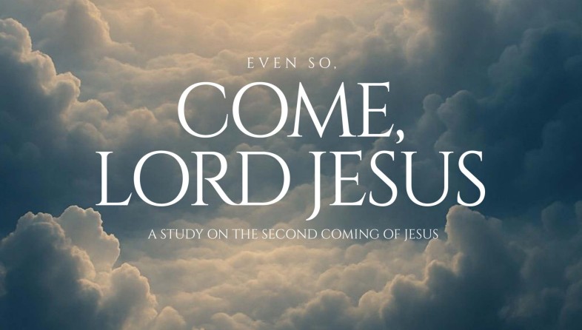
1
Week 1

Slide 2
“Behold, He is coming with the clouds, and every eye will see Him, even those who pierced Him, and all tribes of the earth will wail on account of Him. Even so. Amen” (Revelation 1:7 – ESV).
2
What does it mean that all tribes of the earth will “wail”?
Page 8

Slide 3
29 “But immediately after the tribulation of those days the sun will be darkened, and the moon will not give its light, and the stars will fall from the sky, and the powers of the heavens will be shaken. 30 And then the sign of the Son of Man will appear in the sky, and then all the tribes of the earth will mourn, and they will see the Son of Man coming on the clouds of the sky with power and great glory. 31 And He will send forth His angels with a great trumpet blast, and they will gather together His elect from the four winds, from one end of the sky to the other.
3
Matthew 24:29-31 (NASB)

Slide 4
But if we do not first come to grips with the reality of our sin nature and realize the magnitude of sin’s grip on us that justifies the sentence of condemnation being delivered against us by Jesus, the Judge, then the Second Coming of Jesus will amount to nothing more than just one of many profound movements of God in history.
4
Why is the second coming important to understand?
Page 14

Slide 5
The fall of mankind in the Garden of Eden is discussed in pages 9-14 Then at the end, discussion question 5 asks: On a scale of 1-5, how much do you understand about original sin? (page 19) What do you suppose original sin has to do with the return of Christ?
5

Slide 6
12 Therefore, just as through one man sin entered into the world, and death through sin, and so death spread to all mankind, because all sinned— 13 for until the Law sin was in the world, but sin is not counted against anyone when there is no law. 14 Nevertheless death reigned from Adam until Moses, even over those who had not sinned in the likeness of the violation committed by Adam, who is a type of Him who was to come.
6
Where does that grip of sin originate?
Romans 5

Slide 7
22 For as in Adam all die, so also in Christ all will be made alive.
7
Where does that grip of sin originate?
I Corinthians 15

Slide 8
22 For as in Adam all die, so also in Christ all will be made alive.
8
Where does that grip of sin originate?
I Corinthians 15
What about Children and the Age of Accountability?

Slide 9
22 For as in Adam all die, so also in Christ all will be made alive.
9
Where does that grip of sin originate?
I Corinthians 15
What about Children and the Age of Accountability?
13 for until the Law sin was in the world, but sin is not counted against anyone when there is no law.

Slide 10
12 Therefore, just as through one man sin entered into the world, and death through sin, and so death spread to all mankind, because all sinned— 13 for until the Law sin was in the world, but sin is not counted against anyone when there is no law. 14 Nevertheless death reigned from Adam until Moses, even over those who had not sinned in the likeness of the violation committed by Adam, who is a type of Him who was to come.
10
Where does that grip of sin originate?
Romans 5
This is called Federal Headship!

Slide 11
In theology, federal headship is the theory used to explain imputation—how the result of Adam’s sin was imputed to all his descendants and how the results of a righteous Christ is imputed to those who believe the gospel. According to the federal headship, Adam was the federal (or representative) head of the human race; Adam chose to sin, resulting in a fallen state, and all of us are also in because he was our representative. Federal headship is seen as the explanation of Paul’s comparison of the roles of Adam and Christ in Romans 5:18: “As one trespass led to condemnation for all men, so one act of righteousness leads to justification and life for all men” (ESV). So, Adam’s sin brought condemnation on the human race; Christ’s sacrifice brought salvation to the human race. The idea of federal headship involves the teaching that Adam was the first representative of the human race and Christ is the second representative. The second, or “last Adam” (I Corinthians 15:45)
11
What is federal headship?

Slide 12
But for believers, the Second Coming of Jesus will bring to completion the work of sanctification that He began when those believers first professed Jesus as Lord and Savior. This is the moment when everything wrong will be made right. American theologian, John Piper, writes that in the Second Coming of Jesus, “God’s aim is that we move from forgiven sinners to forgiven and sinless... That change will happen at the coming of Christ.”
12
Page 14

