Slide 1
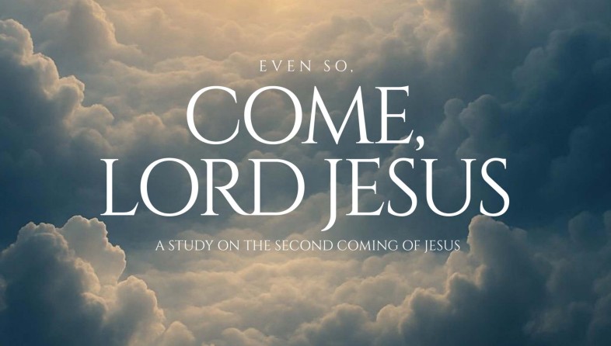
12
Week 2

Slide 2
Question
13
Why is it important to understand that the Second Coming was part of God’s plan from the beginning and not a “Plan B”?

Slide 3
Historic Premillennialism is explained well Dr. Walter Martin who was the Bible Answer Man on radio as well as college teacher and frequent guest on The John Ankerberg Show. Dr. Martin wrote the book “Kingdom of The Cults” which is still used as a text book today to teach about cults.
Here is Dr. Martin on the subject
14
https://bibletruthorfiction.com/premillennialism.html

Slide 4
15
The Golden Rule Of Interpretation
Is a literal interpretation always the best idea?
If the literal sense makes sense, search for no other sense lest you find nonsense.

Slide 5

16
Is a literal interpretation always the best idea?

Slide 6
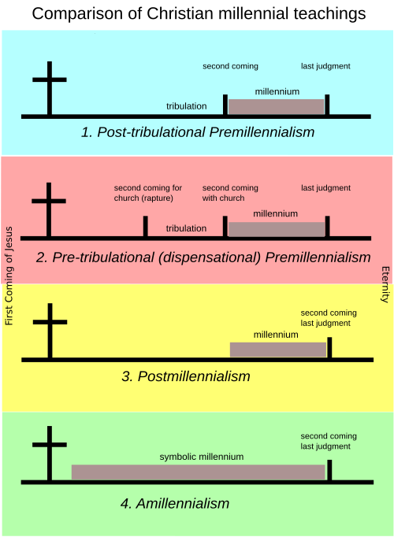
17

Slide 7
18
Is a literal interpretation always the best idea?
Where does the idea of a
“Plan B” come from?

Slide 8
Genesis17:9 “Then God said to Abraham, “As for you, you must keep my covenant, you and your descendants after you for the generations to come. 10 This is my covenant with you and your descendants after you, the covenant you are to keep: Every male among you shall be circumcised.”
19
Abrahamic Covenant

Slide 9
Jeremiah 31
20
There is a gap of approximately 75-80 years between the ministries of the prophets Isaiah and Jeremiah. Isaiah's ministry is generally placed between 740 and 680 BCE, while Jeremiah's began around 626 BCE and continued until after the fall of Jerusalem in 586 BCE.
Jeremiah 31:31-33 “Behold, days are coming,” declares the Lord, “when I will make a new covenant with the house of Israel and the house of Judah, 32 not like the covenant which I made with their fathers on the day I took them by the hand to bring them out of the land of Egypt, My covenant which they broke, although I was a husband to them,” declares the Lord. 33 “For this is the covenant which I will make with the house of Israel after those days,” declares the Lord: “I will put My law within them and write it on their heart; and I will be their God, and they shall be My people.

Slide 10
21
Dispensational Premillennialism emphasizes distinct historical periods (dispensations) and separates God's dealings with Israel and the Church, viewing Israel as having earthly promises and the Church as having heavenly ones. In contrast, Covenant Theology views God's plan as a unified narrative of covenants, seeing the Church as the spiritual fulfillment of Israel's promises and a single people of God, rather than two separate entities

Slide 11
22
Dispensational Premillennialism emphasizes distinct historical periods (dispensations) and separates God's dealings with Israel and the Church, viewing Israel as having earthly promises and the Church as having heavenly ones. In contrast, Covenant Theology views God's plan as a unified narrative of covenants, seeing the Church as the spiritual fulfillment of Israel's promises and a single people of God, rather than two separate entities
The separate dealings of the church and Israel is why the church is called plan b

Slide 12
22
Because the Jews rejected Christ, in Dispensational Premillennialism The church became “Plan B”. Otherwise Daniel would have prophesied about 69 weeks followed by an indefinite period of time. THAT THE 70TH WEEK HAD TO BE PAUSED INDICATES A CHANGE IN PLAN AS DANIEL PROHESIED!
Plan B comes specifically from this idea.

Slide 13
23
Is a literal interpretation always the best idea?

Slide 14
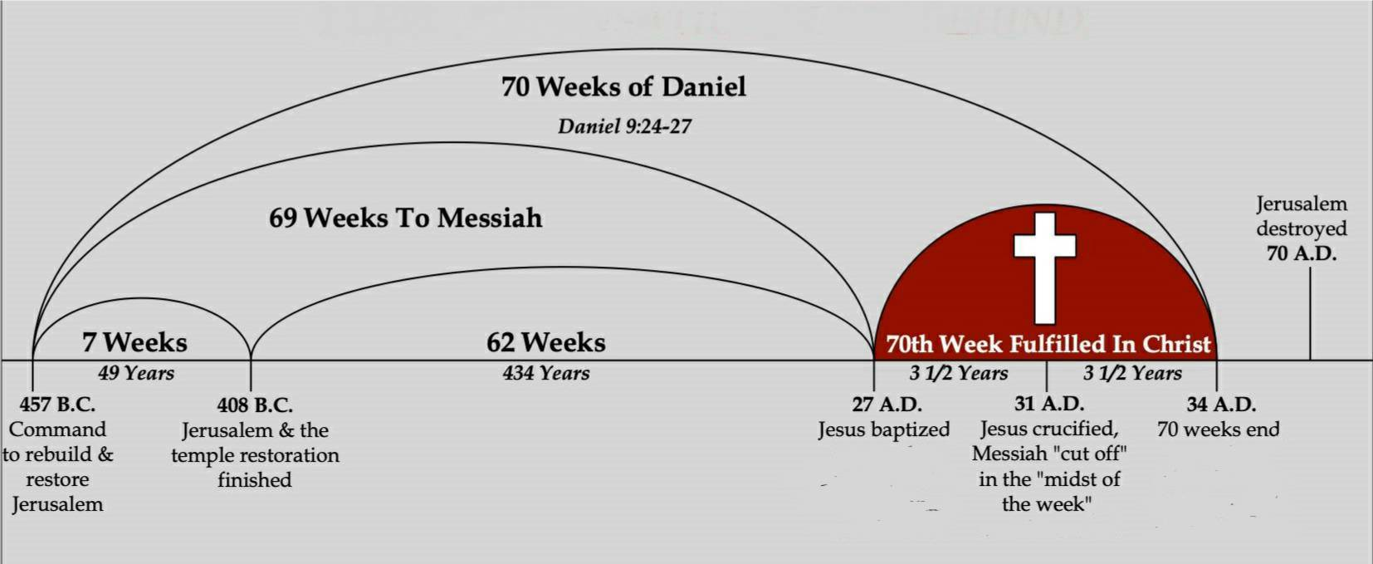
24
This is Daniels 70 weeks literally.

Slide 15
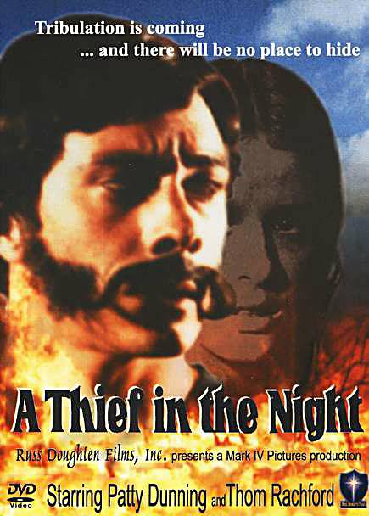
25
The original rapture movie from 1973, based on Hal Linsey’s “The Late Great Planet Earth (1970).

Slide 16
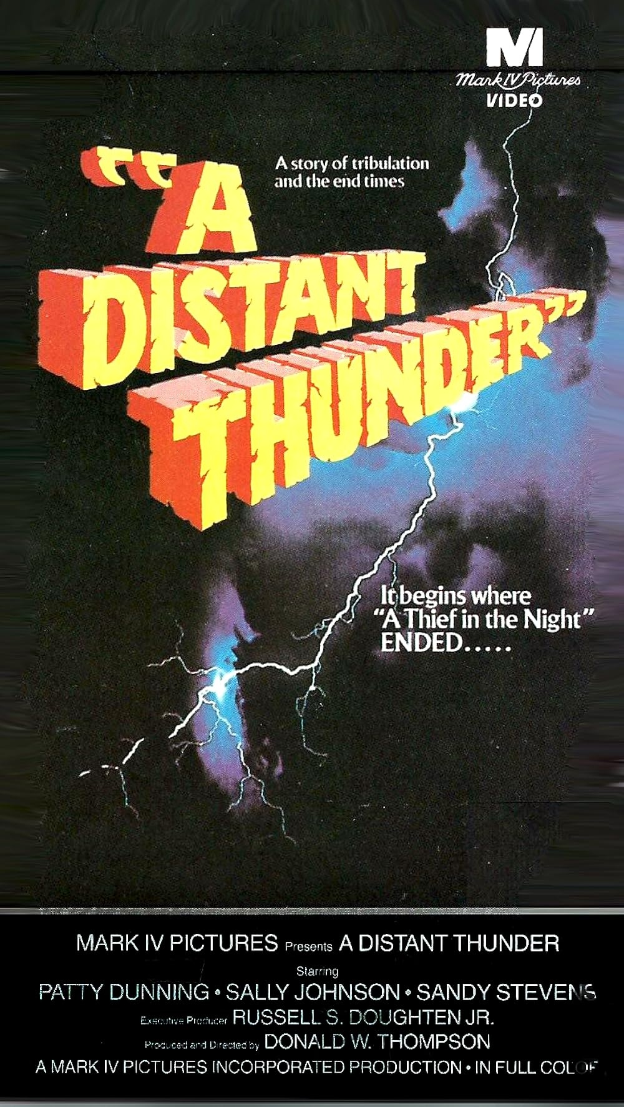
26
Followed by “A distant Thunder” in 1978

Slide 17
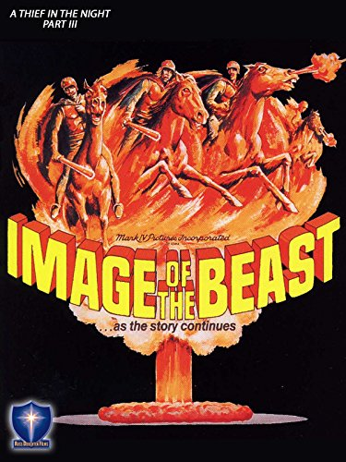
27
Image of the Beast 1981

Slide 18

28
The Prodigal Planet 1983

Slide 19
Here is the history:
29
1908 BIOLA the Bible Institute of Los Angeles was founded
1913 Philadelphia College of Bible (Cairn University)
1914 Moody Bible Institute offered the Scofield Bible Course.
1921 Faith Baptist Theological Seminary, Iowa
1924 Dallas Theological Seminary
1937 Grace Theological Seminary, Winona Lake, Indiana

Slide 20
Here is the history:
30
In the 1990’s Dispensationalism was in decline.
John F. Walvoord criticized both the movies and Hal Linsey calling them “pop-dispensationalist” while calling himself a “classic-dispensationalist”
Later dispensationalist known as “neo-dispensationalist”, or “progressive-dispensationalist” tried to meld together Covenant Theology with Dispensational Theology.

Slide 21
Question 3
31
Why is it important to understand that the Second Coming was part of God’s plan from the beginning and not a “Plan B”?
Page 42

