Slide 1
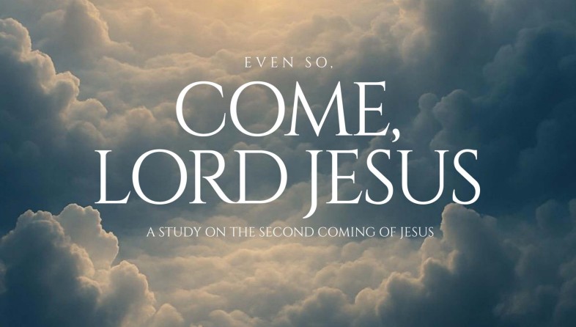
49
Week 4

Slide 2

50

Slide 3
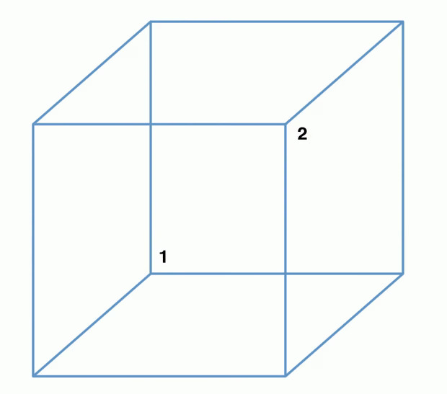
51

Slide 4
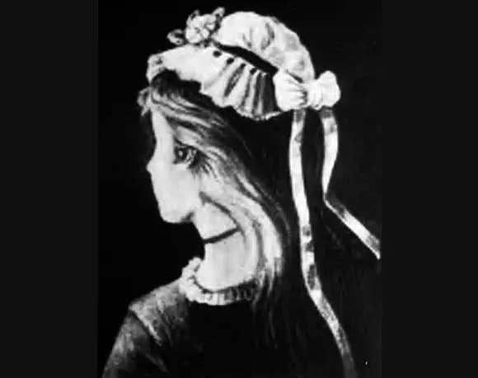
52

Slide 5
53
She likes her more than me.

Slide 6
54
She likes her more than me.
We saw her duck.

Slide 7
55
She likes her more than me.
We saw her duck.
I watched the man with the telescope.

Slide 8
56
She likes her more than me.
We saw her duck.
I watched the man with the telescope.
Save soap and waste paper.

Slide 9
Revelation 20
57
Then I saw an angel coming down from heaven, holding the key of the abyss and a great chain in his hand. 2 And he took hold of the dragon, the serpent of old, who is the devil and Satan, and bound him for a thousand years; 3 and he threw him into the abyss and shut it and sealed it over him, so that he would not deceive the nations any longer, until the thousand years were completed; after these things he must be released for a short time.

Slide 10
Mark 3:22-27
58
22 The scribes who came down from Jerusalem were saying, “He is possessed by Beelzebul,” and “He casts out the demons by the ruler of the demons.” 23 And so He called them to Himself and began speaking to them in parables: “How can Satan cast out Satan? 24 And if a kingdom is divided against itself, that kingdom cannot stand. 25 If a house is divided against itself, that house will not be able to stand. 26 And if Satan has risen up against himself and is divided, he cannot stand, but he is finished! 27 But no one can enter the strong man’s house and plunder his property unless he first ties up the strong man, and then he will plunder his house.

Slide 11
Revelation 20:4
59
4. Then I saw thrones, and they sat on them, and judgment was given to them.
Who is the “them”?

Slide 12
Revelation 20:4
60
4. Then I saw thrones, and they sat on them, and judgment was given to them.
The "divine council" refers to a heavenly assembly of spiritual beings who serve under God, and participate in the governance of creation. Passages such as Deuteronomy 32:8, 1 Kings 22:19–23, Job 1:6–12, and Isaiah 6 all describe God's interactions with this council. The council includes beings like the "sons of God" and even a rebellious figure referred to as Satan.
The Unseen Realm

Slide 13
Revelation 20:4
61
4. Then I saw thrones, and they sat on them, and judgment was given to them.
And I saw the souls of those who had been beheaded because of their testimony of Jesus and because of the word of God, and those who had not worshiped the beast or his image, and had not received the mark on their foreheads and on their hands; and they came to life and reigned with Christ for a thousand years.

Slide 14
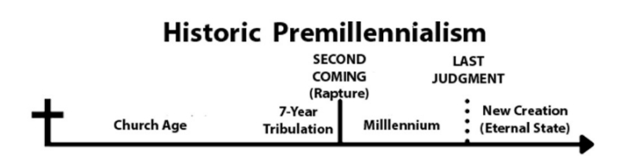
62
At this point in my journey, I (Jerry) fall in this camp, though I am also drawn to the Amillennial position. The sticking point for me is the 1,000-year reign of Jesus taking place during a literal rather than a symbolic period of time.

Slide 15
64
Historic premillennialism was widely held in the first three centuries of Christianity by figures like Papias and Irenaeus, before Augustine's influence led to the prominence of amillennialism in the fourth century.

Slide 16
65
Papias did not teach about a seven-year tribulation. This concept, popularized by 19th-century Dispensationalism, differs significantly from Papias's view, which was part of a tradition known as chiliasm, or premillennialism.

Slide 17
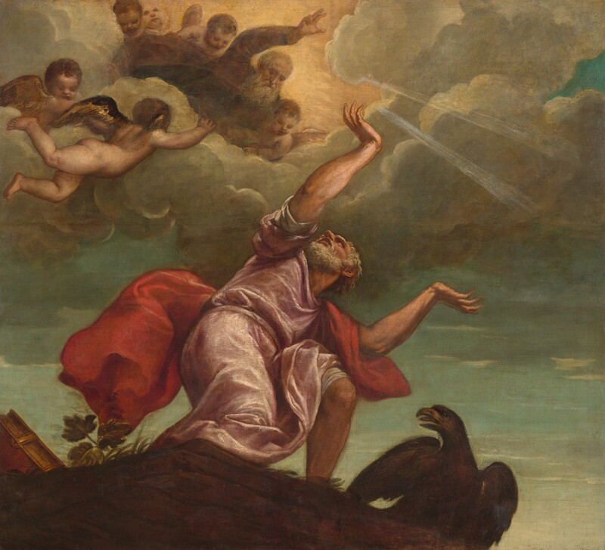
Irenaeus or Papias would never have considered The Revelation of John it was not considered cannon until after their time.
66
Synod of Hippo (393 AD) and the Council of Carthage (397 AD). Its acceptance was a gradual and sometimes contentious process, as some churches and figures initially had doubts about its authorship and content, leading to a varied reception in the early centuries of Christianity.

Slide 18
67
I Thessalonians 4:13-17
13 But we do not want you to be uninformed, brothers and sisters, about those who are asleep, so that you will not grieve as indeed the rest of mankind do, who have no hope. 14 For if we believe that Jesus died and rose from the dead, so also God will bring with Him those who have fallen asleep through Jesus. 15 For we say this to you by the word of the Lord, that we who are alive and remain until the coming of the Lord will not precede those who have fallen asleep. 16 For the Lord Himself will descend from heaven with a shout, with the voice of the archangel and with the trumpet of God, and the dead in Christ will rise first. 17 Then we who are alive, who remain, will be caught up together with them in the clouds to meet the Lord in the air, and so we will always be with the Lord.

Slide 19
I Corinthians 15:50-57
68
50 Now I say this, brothers and sisters, that flesh and blood cannot inherit the kingdom of God; nor does the perishable inherit the imperishable. 51 Behold, I am telling you a mystery; we will not all sleep, but we will all be changed, 52 in a moment, in the twinkling of an eye, at the last trumpet; for the trumpet will sound, and the dead will be raised imperishable, and we will be changed. 53 For this perishable must put on the imperishable, and this mortal must put on immortality. 54 But when this perishable puts on the imperishable, and this mortal puts on immortality, then will come about the saying that is written: “Death has been swallowed up in victory. 55 Where, O Death, is your victory? Where, O Death, is your sting?” 56 The sting of death is sin, and the power of sin is the Law; 57 but thanks be to God, who gives us the victory through our Lord Jesus Christ.

Slide 20
Revelation 20:7-9a
69
7 When the thousand years are completed, Satan will be released from his prison, 8 and will come out to deceive the nations which are at the four corners of the earth, Gog and Magog, to gather them together for the war; the number of them is like the sand of the seashore. 9 And they came up on the broad plain of the earth and surrounded the camp of the saints and the beloved city,…….

Slide 21
Revelation 20:7-9a
70
7 When the thousand years are completed, Satan will be released from his prison, 8 and will come out to deceive the nations………
Who is left for Satan to deceive in light of I Corinthians 15?

Slide 22
What does “ekklesia” mean?
71

Slide 23
What does “ekklesia” mean?
72
The Greek word ekklesia originally referred to a political assembly or governing body in ancient Greece, such as the assembly of citizens in Athens who made decisions on matters of civil policy, law, and foreign affairs. It was not initially a religious term, but a civic one, describing a group of citizens "called out" from the general populace to serve as an executive or legislative arm.

Slide 24
Ekklesia in Ancient Greece
73
Citizen Assemblies: The ekklesia was the sovereign governing body in many Greek city-states, most notably Athens, where male citizens gathered to discuss and vote on proposals.
Key Decisions: These assemblies handled crucial matters like law-making, foreign policy, treaties, war, peace, and appointments to public office.
Physical Gathering: It was a physical, real-world institution with real responsibilities, often meeting at a specific location, like the Pnyx in Athens.
Transition to Religious Context
Pre-existing Term: Early Christians adopted the term ekklesia because it was already familiar to their audiences, who understood it as a powerful, decision-making body.
Shifting Meaning: The term's meaning later shifted in Christian usage to describe the gathering of believers, eventually becoming the word for "church" in English.

Slide 25
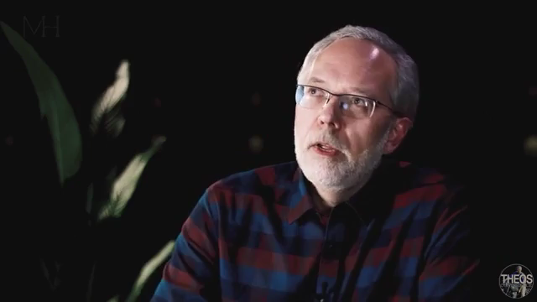
This was not a symbolic millennium it was in a literal millennial rule from Heaven!
74

Slide 26
75
Revelation 3:21-22
²¹ The one who overcomes, I will grant to him to sit with Me on My throne, as I also overcame and sat with My Father on His throne. ²² The one who has an ear, let him hear what the Spirit says to the churches.’”

