Slide 1
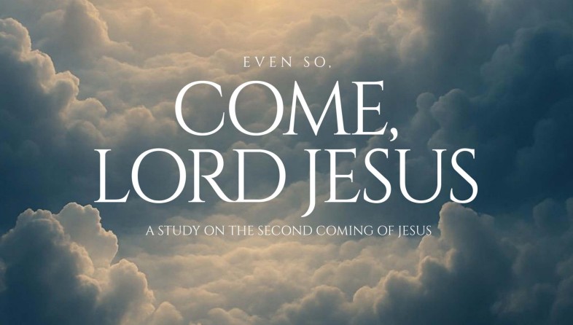
103
Week 6

Slide 2
Deuteronomy 7:6
104
6 For you are a holy people to the LORD your God; the LORD your God has chosen you

Slide 3
Deuteronomy 7:6
105
6 For you are a holy people to the LORD your God; the LORD your God has chosen you to be a people for His own possession out of all the peoples who are on the face of the earth.

Slide 4
Deuteronomy 7:6
106
6 For you are a holy people to the LORD your God; the LORD your God has chosen you to be a people for His own possession out of all the peoples who are on the face of the earth.
Strong's 5459. Segullah

Slide 5
Deuteronomy 7:6
107
to be a people for His own possession out of all the peoples who are on the face of the earth.
Strong's 5459. Segullah
NASB: possession, treasure, treasured possession

Slide 6
New international version
108
New International Version Exodus 19:5
Now if you obey me fully and keep my covenant, then out of all nations you will be my treasured possession. Although the whole earth is mine
New International Version Psalm 134:5
For the LORD has chosen Jacob to be his own, Israel to be his treasured possession.
Malachi 3:17
“On the day when I act,” says the LORD Almighty, “they will be my treasured possession. I will spare them, just as a father has compassion and spares his son who serves him
Deuteronomy 14:2
Out of all the peoples on the face of the earth, the Lord has chosen you to be his treasured possession.
Deuteronomy 26:18
And the Lord has declared this day that you are his people, his treasured possession as he promised, and that you are to keep all his commands.

Slide 7
Matthew 25:1-8
109
1"Then the kingdom of heaven will be comparable to ten virgins, who took their lamps and went out to meet the bridegroom 2 "Five of them were foolish, and five were prudent. 3 "For when the foolish took their lamps, they took no oil with them, 4 but the prudent took oil in flasks along with their lamps. 5 "Now while the bridegroom was delaying, they all got drowsy and [began] to sleep. 6 "But at midnight there was a shout, 'Behold, the bridegroom! Come out to meet [him].' 7 "Then all those virgins rose and trimmed their lamps. 8 "The foolish said to the prudent, 'Give us some of your oil, for our lamps are going out.

Slide 8
Matthew 25:9-13
110
9 "But the prudent answered, 'No, there will not be enough for us and you [too]; go instead to the dealers and buy [some] for yourselves.' 10 "And while they were going away to make the purchase, the bridegroom came, and those who were ready went in with him to the wedding feast; and the door was shut. 11 "Later the other virgins also came, saying, Lord, lord, open up for us.' 12 "But he answered, 'Truly I say to you, I do not know you.' 13 "Be on the alert then, for you do not know the day nor the hour.

Slide 9
Matthew 25:9-13
111
9 "But the prudent answered, 'No, there will not be enough for us and you [too]; go instead to the dealers and buy [some] for yourselves.' 10 "And while they were going away to make the purchase, the bridegroom came, and those who were ready went in with him to the wedding feast; and the door was shut. 11 "Later the other virgins also came, saying, Lord, lord, open up for us.' 12 "But he answered, 'Truly I say to you, I do not know you.' 13 "Be on the alert then, for you do not know the day nor the hour.

Slide 10
Matthew 24:36
112
36 “But about that day and hour no one knows, not even the angels of heaven, nor the Son, but the Father alone..

Slide 11
Evidence for a Hebrew/Aramaic Original:
113
Early Church Tradition: Several early Christian writers, including Papias, Irenaeus, Eusebius, Epiphanius and Origen, claimed Matthew wrote the Gospel in Hebrew or a Hebrew dialect.
Aramaic Source Material: The canonical Greek Gospel of Matthew contains Aramaic words and phrases, and scholars note that it shows signs of having been translated from Aramaic which was a Hebrew dialect.

Slide 12
Matthew 25:1
114
1 "Then the kingdom of heaven will be comparable to ten virgins, who took their lamps and went out to meet the bridegroom and the bride.

Slide 13
Matthew 25:1
115
1 "Then the kingdom of heaven will be comparable to ten virgins, who took their lamps and went out to meet the bridegroom and the bride.
This Hebrew version traces back to about 1286, and appeared in print in 1380 in an anti-Christian writing by a Rabbi called “The Touchstone”

Slide 14
Matthew 25:1
116
The oldest version of Matthew in Greek is Codex Vaticanus which was created between approximately AD 325 and 350.
This Hebrew version traces back to about 1286, and appeared in print in 1380 in an anti-Christian writing by a Rabbi called “The Touchstone”

Slide 15
Matthew 25:1
117
1 "Then the kingdom of heaven will be comparable to ten virgins, who took their lamps and went out to meet the bridegroom.
Who is the bridegroom to the Jews?

Slide 16
Matthew 25:1
118
1 "Then the kingdom of heaven will be comparable to ten virgins, who took their lamps and went out to meet the bridegroom.
Who is the bridegroom to the Jews?
The Messiah

Slide 17
Matthew 25:1
119
1 "Then the kingdom of heaven will be comparable to ten virgins, who took their lamps and went out to meet the bridegroom.
Who are the virgins to the Jews?

Slide 18
Matthew 25:1
120
1"Then the kingdom of heaven will be comparable to ten virgins, who took their lamps and went out to meet the bridegroom.
Who are the virgins to the Jews?
The Jewish People

Slide 19
Matthew 25:1
121
When Jesus spoke of the "kingdom of heaven," Jews understood it as a concept already familiar to them, referring to God's reign and his active rule on Earth
"Malkut Shamayim" (מַלְכוּת שָׁמַיִם) is) a Hebrew phrase that translates to the "Kingdom of Heaven" or the "Kingdom of God," and it can refer to two concepts: God's rule in the present world or God's future reign over all creation.

Slide 20
Summary
122
The Bridegroom is the then awaited Messiah.
The Kingdom of Heaven on earth is what the Jews anticipated the Messiah would usher in.
There is no bride mentioned in this parable
The Virgins are the Jewish people who are being urged by Jesus to be ready.
The Jews no not the hour.

Slide 21
Revelation 19:7-9
123
7 Let’s rejoice and be glad and give the glory to Him, because the marriage of the Lamb has come, and His bride has prepared herself.” 8 It was given to her to clothe herself in fine linen, bright and clean; for the fine linen is the righteous acts of the saints. 9 Then he said to me, “Write: ‘Blessed are those who are invited to the wedding feast of the Lamb.’”

Slide 22
Revelation 19:7-9
123
7 Let’s rejoice and be glad and give the glory to Him, because the marriage of the Lamb has come, and His bride has prepared herself.
Who is the Lamb?

Slide 23
Revelation 19:7-9
124
7 Let’s rejoice and be glad and give the glory to Him, because the marriage of the Lamb has come, and His bride has prepared herself.
Who is the Lamb? Jesus

Slide 24
Revelation 19:7-9
125
7 Let’s rejoice and be glad and give the glory to Him, because the marriage of the Lamb has come, and His bride has prepared herself.
Who is the bride?

Slide 25
Revelation 19:7-9
126
7 Let’s rejoice and be glad and give the glory to Him, because the marriage of the Lamb has come, and His bride has prepared herself.
Who is the bride? The Church

Slide 26
Revelation 19:9
127
9 Then he said to me, “Write: ‘Blessed are those who are invited to the wedding feast of the Lamb.’”
Who are the those invited to the wedding feast?

Slide 27
Revelation 19:9
128
9 Then he said to me, “Write: ‘Blessed are those who are invited to the wedding feast of the Lamb.’”
Who is invited to the wedding feast?
The righteous before the church age.

Slide 28
Revelation 19:9
129
The righteous before the church age.
These are those who are forgiven by Christ just as His church has been.
The church ARE the saved by Christ. The guests are those that lived before the church age but are invited to partake of the feast because of their righteousness.

