Slide 1
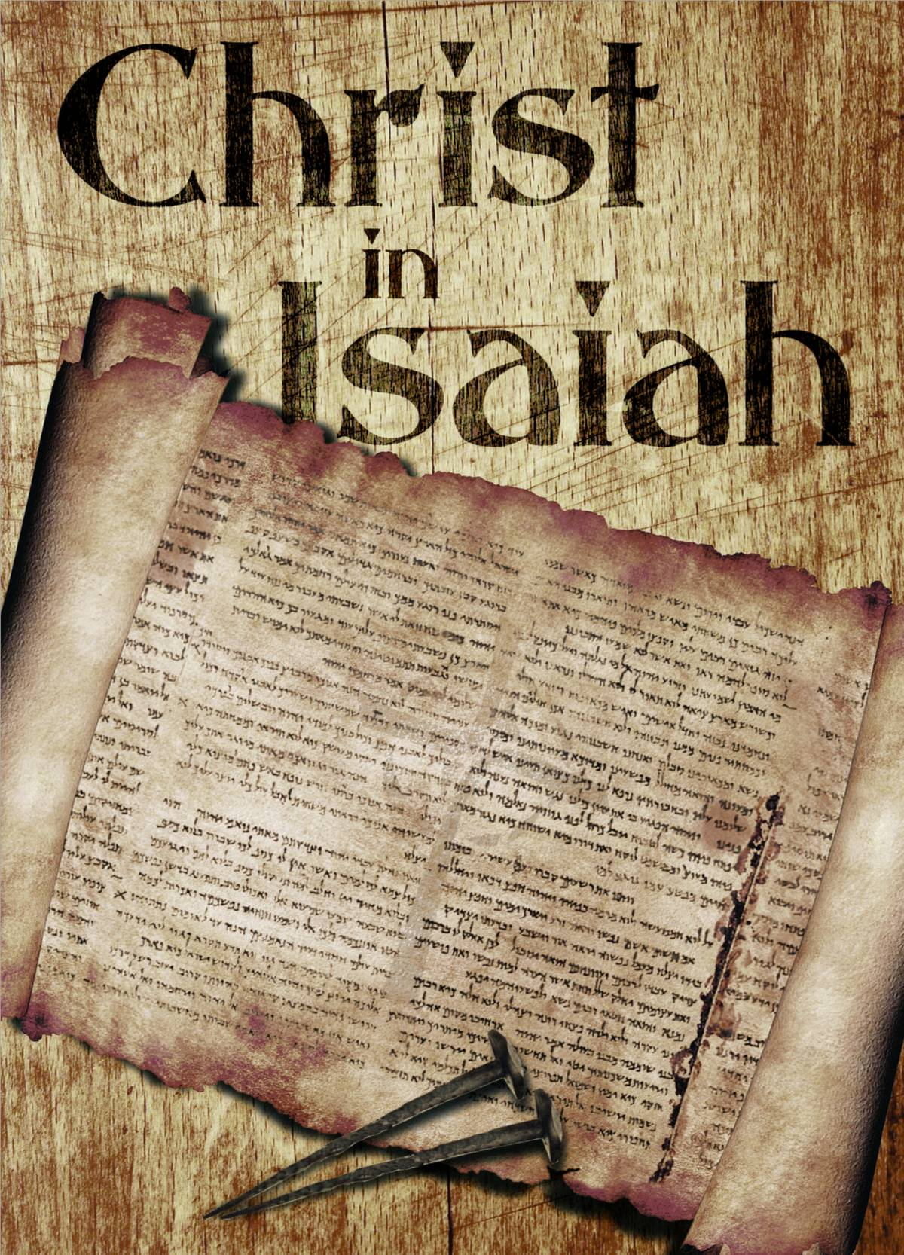
81
WEEK 4
11-09-25

Slide 2
82
Isaiah 41:4
Who has performed and accomplished it,
Summoning the generations from the beginning?
‘I, the Lord, am the first, and with the last. I am He.’

Slide 3
83
Isaiah 44:6
“This is what the Lord says, He who is the King of Israel and his Redeemer, the Lord of armies:
‘I am the first and I am the last,
And there is no God besides Me.

Slide 4
84
Isaiah 48:12
“Listen to Me, Jacob, Israel whom I called;
I am He, I am the first, I am also the last.

Slide 5
85
Revelation 22:13
I am the Alpha and the Omega, the First and the Last, the Beginning and the End.
Why add to this the Alpha and Omega?

Slide 6
86
The basic formula
You know the basic formula, if it is said in the bible once, listen. If the bible says it twice, pay close attention. If it says it three times find out why!

Slide 7
87
The basic formula
You know the basic formula, if it is said in the bible once, listen. If the bible says it twice, pay close attention. If it says it three times find out why!
Revelation 1:8: "I am the Alpha and the Omega, the beginning and the ending, says the Lord, which is, and which was, and which is to come, the Almighty".
Revelation 21:6: "I am the Alpha and the Omega, the beginning and the end".
Revelation 22:13: "I am the Alpha and the Omega, the First and the Last, the Beginning and the End".

Slide 8
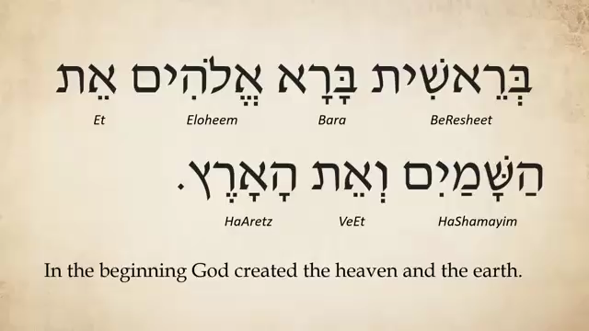
Genesis 1:1
88

Slide 9
Arab Proverb
89
In 1893 Isabel Burton published a two volume biography of her husband Richard Francis Burton who was a famous British explorer and scholar. The first volume included an instance of the saying:

Slide 10
Arab Proverb
90
In 1893 Isabel Burton published a two volume biography of her husband Richard Francis Burton who was a famous British explorer and scholar. The first volume included an instance of the saying:
‘Men are four. He who knows not, and knows not he knows not, he is a fool—shun him; he who knows not, and knows he knows not, he is simple—teach him; he who knows, and knows not he knows, he is asleep—wake him; he who knows, and knows he knows, he is wise—follow him.’—

Slide 11
Arab Proverb
91
In 1893 Isabel Burton published a two volume biography of her husband Richard Francis Burton who was a famous British explorer and scholar. The first volume included an instance of the saying:
‘Men are four. He who knows not, and knows not he knows not, he is a fool—shun him; he who knows not, and knows he knows not, he is simple—teach him; he who knows, and knows not he knows, he is asleep—wake him; he who knows, and knows he knows, he is wise—follow him.’—

Slide 12
Arab Proverb
92
In 1893 Isabel Burton published a two volume biography of her husband Richard Francis Burton who was a famous British explorer and scholar. The first volume included an instance of the saying:
‘Men are four. He who knows not, and knows not he knows not, he is a fool—shun him; he who knows not, and knows he knows not, he is simple—teach him; he who knows, and knows not he knows, he is asleep—wake him; he who knows, and knows he knows, he is wise—follow him.’—

Slide 13
Arab Proverb
93
In 1893 Isabel Burton published a two volume biography of her husband Richard Francis Burton who was a famous British explorer and scholar. The first volume included an instance of the saying:
‘Men are four. He who knows not, and knows not he knows not, he is a fool—shun him; he who knows not, and knows he knows not, he is simple—teach him; he who knows, and knows not he knows, he is asleep—wake him; he who knows, and knows he knows, he is wise—follow him.’—

Slide 14
94
haftarah
Haftarah means "conclusion" or "ending" in Hebrew and refers to a reading from the biblical Books of the Prophets (Nevi'im). This is read every Sabbat and Holy Days.

Slide 15
95
Historical background
The most common explanation for the beginning of the Haftarah is that in 168 BCE, when the Jews were under the rule of the Seleucid (Greeks) King Antiochus IV Epiphanes , they were forbidden to read from the Torah. The decree, however, was limited to the Five Books of Moses, so the sages instituted that a section of the Prophets be read instead, usually an idea that was related to the Torah reading that should have been read that week. This custom stuck even after it became safe to read from the Torah again.

Slide 16
96
Historical background
Dr Eitan Bar from the ministry of One For Israel writes in an article about a Jewish historian from the 17th century:
His name was Raphael Levi, and he admitted that at that time, the rabbis were encountering quite a conundrum with regard to Isaiah 53. In synagogues all over the world since Jews gathered in synagogues, they all read the same Torah portions and sections of the historical, prophetic and poetry books each Shabbat. So you can go back in history to any given week and know what portions of the Bible any given synagogue congregation was reading and learning about. It continues to this day, and Jewish congregations make their way through the entire Bible – together – in the space of each calendar year. It’s a great thing.

Slide 17
97
Historical background
However, every time the congregations got to the section in Isaiah that described the suffering servant in chapter 53, actually the description begins in chapter 52, “arguments and great confusion” would break out amongst the congregants. What or who was Isaiah talking about…it sounds very, very, very much like the description of the Christians describing Jesus.
So, the rabbis felt the best way to deal with this issue was to simply remove the offending passage from the synagogue readings altogether. Starting in the middle of Isaiah 52 and all of Isaiah 53, those portions were completely removed. No more problem!

Slide 18
98
Historical background
However, every time the congregations got to the section in Isaiah that described the suffering servant in chapter 53, actually the description begins in chapter 52, “arguments and great confusion” would break out amongst the congregants. What or who was Isaiah talking about…it sounds very, very, very much like the description of the Christians describing Jesus.
So, the rabbis felt the best way to deal with this issue was to simply remove the offending passage from the synagogue readings altogether. Starting in the middle of Isaiah 52 and all of Isaiah 53, those portions were completely removed. No more problem!

Slide 19
99
Jewish interpretation of Isaiah 53
Collective interpretation (the nation of Israel)
The suffering of Israel: This view sees the passage as a metaphor for the Jewish people's suffering throughout their history, enduring persecution and exile at the hands of other nations.
The speakers: The passage is interpreted as a lament from the perspective of the gentile nations, who, in the messianic age, will come to recognize the great suffering Israel endured and acknowledge the wrong they have done.
Biblical precedent: This interpretation is supported by the fact that Israel is frequently called God's "servant" elsewhere in the book of Isaiah (e.g., Isaiah 41:8-9, 49:3).

Slide 20
100
Jewish interpretation of Isaiah 53
Collective interpretation (the nation of Israel)
The suffering of Israel: This view sees the passage as a metaphor for the Jewish people's suffering throughout their history, enduring persecution and exile at the hands of other nations.
The speakers: The passage is interpreted as a lament from the perspective of the gentile nations, who, in the messianic age, will come to recognize the great suffering Israel endured and acknowledge the wrong they have done.
Biblical precedent: This interpretation is supported by the fact that Israel is frequently called God's "servant" elsewhere in the book of Isaiah (e.g., Isaiah 41:8-9, 49:3).

Slide 21

101
Street interviews in Israel

Slide 22
Isaiah 53
102
1 Who has believed our message? And to whom has the arm of the LORD been revealed?
2 For He grew up before Him like a tender shoot, And like a root out of parched ground; He has no [stately] form or majesty That we should look upon Him, Nor appearance that we should be attracted to Him.
3 He was despised and forsaken of men, A man of sorrows and acquainted with grief; And like one from whom men hide their face He was despised, and we did not esteem Him.
4 Surely our griefs He Himself bore, And our sorrows He carried; Yet we ourselves esteemed Him stricken, Smitten of God, and afflicted.
5 But He was pierced through for our transgressions, He was crushed for our iniquities; The chastening for our well-being [fell] upon Him, And by His scourging we are healed.
6 All of us like sheep have gone astray, Each of us has turned to his own way; But the LORD has caused the iniquity of us all To fall on Him.
7 He was oppressed and He was afflicted, Yet He did not open His mouth; Like a lamb that is led to slaughter, And like a sheep that is silent before its shearers, So He did not open His mouth.

Slide 23
Isaiah 53
103
8 By oppression and judgment He was taken away; And as for His generation, who considered That He was cut off out of the land of the living For the transgression of my people, to whom the stroke [was due]?
9 His grave was assigned with wicked men, Yet He was with a rich man in His death, Because He had done no violence, Nor was there any deceit in His mouth.
10 But the LORD was pleased To crush Him, putting [Him] to grief; If He would render Himself [as] a guilt offering, He will see [His] offspring, He will prolong [His] days, And the good pleasure of the LORD will prosper in His hand.
11 As a result of the anguish of His soul, He will see [it and] be satisfied; By His knowledge the Righteous One, My Servant, will justify the many, As He will bear their iniquities.
12 Therefore, I will allot Him a portion with the great, And He will divide the booty with the strong; Because He poured out Himself to death, And was numbered with the transgressors; Yet He Himself bore the sin of many, And interceded for the transgressors.

Slide 24
Isaiah 53
104

Slide 25
Isaiah 53
105
1 Who has believed our report?
And to whom has the arm of the Lord been revealed?
2 For He grew up before Him like a tender shoot,
And like a root out of dry ground;
He has no stately form or majesty
That we would look at Him, (Luke 4:16 & John 1:46)
Nor an appearance that we would take pleasure in Him.

Slide 26
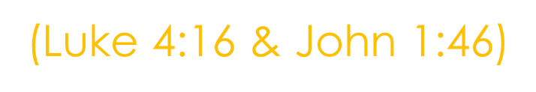
Isaiah 53
106
1 Who has believed our report?
And to whom has the arm of the Lord been revealed? (40:10 Behold, the Lord God will come with might, With His arm ruling for Him.)
2 For He grew up before Him like a tender shoot,
And like a root out of dry ground;
He has no stately form or majesty
That we would look at Him,
Nor an appearance that we would take pleasure in Him.

Slide 27
Isaiah 53
107
1 Who has believed our report?
And to whom has the arm of the Lord been revealed?
2 For He grew up before Him like a tender [a]shoot,
And like a root out of dry ground;
He has no stately form or majesty
That we would look at Him, (Luke 4:16 & John 1:46)
Nathanael's skeptical response, "Can anything good come out of Nazareth?" reflects a common prejudice at the time, as Nazareth was considered a small, unimportant town, and people from Galilee (where Nazareth is located) were often looked down upon.

Slide 28
Isaiah 53
108
3 He was despised and abandoned by men,
A man of great pain and familiar with sickness;
And like one from whom people hide their faces,
He was despised, and we had no regard for Him.

Slide 29
Isaiah 53
109
3 He was despised and abandoned by men,
A man of great pain and familiar with sickness;
And like one from whom people hide their faces,
He was despised, and we had no regard for Him.
Mark12:10
7 But those vine-growers said to one another, ‘This is the heir; come, let’s kill him, and the inheritance will be ours!’ 8 And they took him and killed him, and threw him out of the vineyard. 9 What will the owner of the vineyard do? He will come and put the vine-growers to death, and give the vineyard to others. 10 Have you not even read this Scripture:
‘A stone which the builders rejected,
This has become the chief cornerstone;
11 This came about from the Lord,
And it is marvelous in our eyes’?”

Slide 30
Isaiah 53
110
4 However, it was our sicknesses that He Himself bore,
And our pains that He carried;
Yet we ourselves assumed that He had been afflicted,
Struck down by God, and humiliated.
Who is “WE”?

Slide 31
Isaiah 53
111
4 However, it was our sicknesses that He Himself bore,
And our pains that He carried;
Yet we ourselves assumed that He had been afflicted,
Struck down by God, and humiliated. (Zachariah 12:10)
“And I will pour out on the house of David and on the inhabitants of Jerusalem the Spirit of grace and of pleading, so that they will look at Me whom they pierced; and they will mourn for Him, like one mourning for an only son, and they will weep bitterly over Him like the bitter weeping over a firstborn

Slide 32
Isaiah 53
112
5 But He was pierced for our offenses,
He was crushed for our wrongdoings;
The punishment for our well-being was laid upon Him,
And by His wounds we are healed.

Slide 33
Isaiah 53
113
5 But He was pierced for our offenses,
He was crushed for our wrongdoings;
The punishment for our well-being was laid upon Him,
And by His wounds we are healed.
John 19

Slide 34
Arab Proverb
114
‘Men are four. He who knows not, and knows not he knows not, he is a fool—shun him; he who knows not, and knows he knows not, he is simple—teach him; he who knows, and knows not he knows, he is asleep—wake him; he who knows, and knows he knows, he is wise—follow him.’—

Slide 35

Orthodox Jew street interview #2
115

Slide 37


