Slide 1
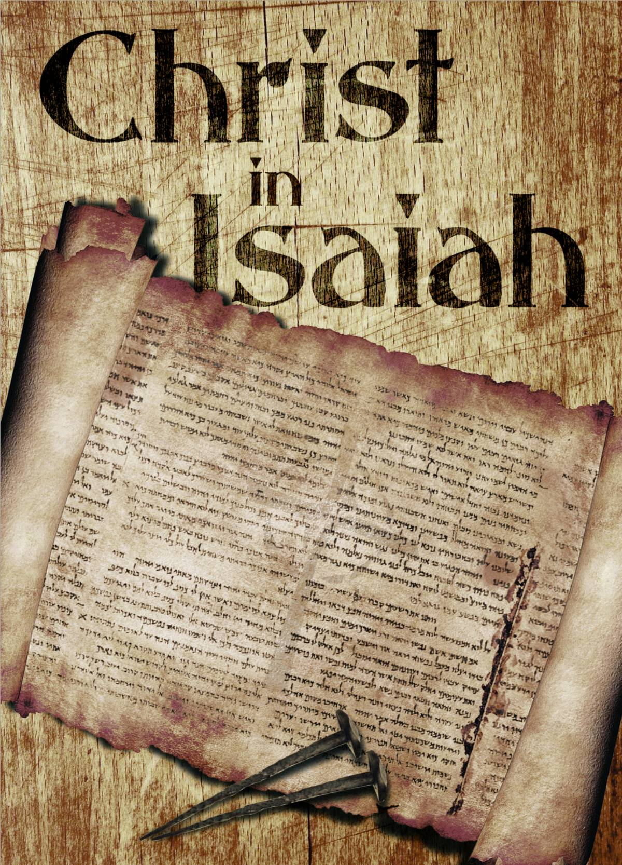
116
WEEK 5
11-16-25

Slide 2
Isaiah recap
117
WEEK 1 10-19-25
Who Wrote Isaiah? Just how is it that scholars determine what should be “scripture”? Or do they?
WEEK 2 10-26-25
The Old Testament is based on the Masoretic Text but when was that made?
WEEK 3 11-2-25
Did Christ actually say He was the Alpha and Omega?
WEEK 4 11-9-25
What chapter in Isaiah is called the “Forbidden Chapter”?

Slide 3
118
Genesis 1:1-3
1 In the beginning God created the heavens and the earth.
2 The earth was formless and void, and darkness was over the surface of the deep, and the Spirit of God was moving over the surface of the waters.
3 Then God said, "Let there be light"; and there was light.

Slide 4
119
Genesis 1:1-3
1 In the beginning God created the heavens and the earth.
2 The earth was formless and void, and darkness was over the surface of the deep, and the Spirit of God was moving over the surface of the waters.
3 Then God said, "Let there be light"; and there was light.
תֹהוּ (Tohu) evokes a scene of shapelessness, desolation, and futility. The word is often paired with בֹּהוּ (“void”) or with verbs of wasting and overthrowing. It can describe physical barrenness, moral emptiness, political ruin, or spiritual vanity. In each context, תֹהוּ stands as the polar opposite of God’s ordered purpose.

Slide 5
120
Genesis 1:1-3
1 In the beginning God created the heavens and the earth.
2 The earth was formless and void, and darkness was over the surface of the deep, and the Spirit of God was moving over the surface of the waters.
3 Then God said, "Let there be light"; and there was light.

Slide 6
121
Genesis 1:1-3
1 In the beginning God created the heavens and the earth.
2 The earth was formless and void, and darkness was over the surface of the deep, and the Spirit of God was moving over the surface of the waters.
3 Then God said, "Let there be light"; and there was light.
בֹּהוּ ( (bohu) describes an uninhabitable emptiness—an evacuated state devoid of structure, order, or life. When paired with תֹּהוּ ( tohu, “formlessness”), it conveys total desolation: first in the primordial creation scene, then in prophetic scenes of judgment. Unlike mere “nothingness,” bohu depicts a tangible ruin that still awaits—or has forfeited—the shaping hand of God.

Slide 7
122
Genesis 1:1-3
1 In the beginning God created the heavens and the earth.
2 The earth was formless and void, and darkness was over the surface of the deep, and the Spirit of God was moving over the surface of the waters.
3 Then God said, "Let there be light"; and there was light.

Slide 8

123
Genesis 1:3

Slide 9
124
Sentence clauses
A sentence clause is a group of words with a subject and a predicate that can be either an independent clause, which can stand alone as a complete sentence, or a dependent clause, which cannot stand alone and must be attached to an independent clause to make sense

Slide 10
125
Sentence clauses Example
Independent clause,
I got in my car and drove away.

Slide 11
126
Sentence clauses Example
Independent clause,
I got in my car and drove away.
Dependent clause,
WHEN I got in my car and drove away

Slide 12
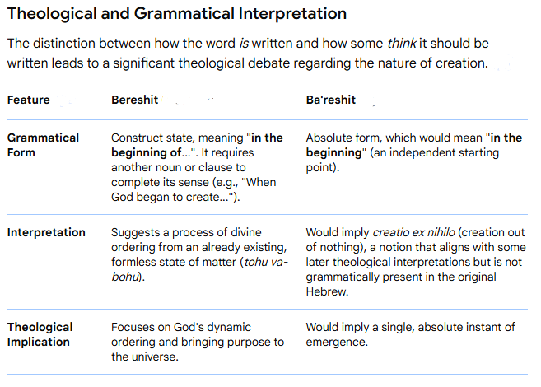
127

Slide 13
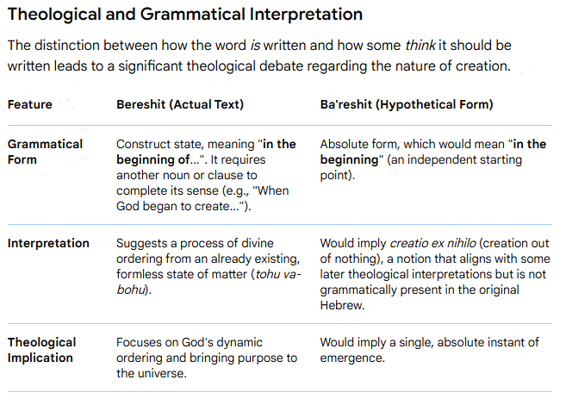
128

Slide 14
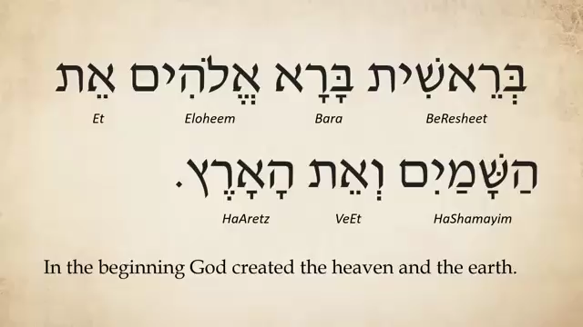
Genesis 1:1
129

Slide 15
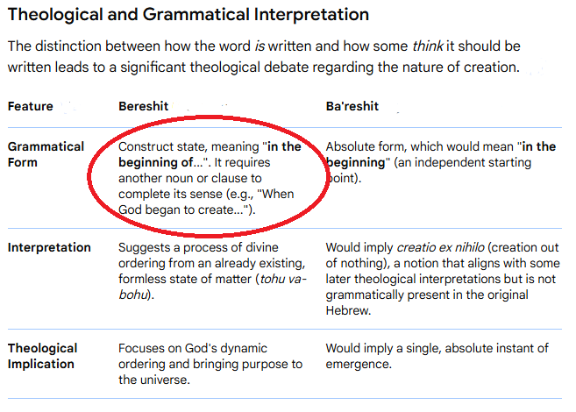
130

Slide 16
131
Genesis 1:1
1 When God began to create the heavens and the earth –
2 Now the earth was void and without form, and darkness was upon the face of the deep. and the Spirit of God was moving over the surface of the waters.
3 Then God said, "Let there be light"; and there was light.

Slide 17
132
Genesis 1:1
Can you translate it this way?
Since 1985 The Jewish Publication Society (JPS) has.
The JPS Tanakh, a modern English translation of the Hebrew Bible that is considered the standard English version by scholars and rabbinic authorities. It is the result of a long collaboration between academic scholars and rabbis, and it is known for being both scholarly and accessible, using modern language while reflecting the original Hebrew's spirit.

Slide 18
133
Genesis 1:1
1 When God began to create the heavens and the earth –
2 Now the earth was void and without form, and darkness was upon the face of the deep. and the Spirit of God was moving over the surface of the waters.
3 Then God said, "Let there be light"; and there was light. First act of creation after the Universe we are told about.

Slide 19
134
Science and bible conflict?
There is no conflict between science and the bible once you understand that Genesis is about the part of creation that involves mankind only! There is no account of the creation of angels for example.

Slide 21


